Slide 1
English Writing

Slide 2
Sentence Structures
01

Slide 3
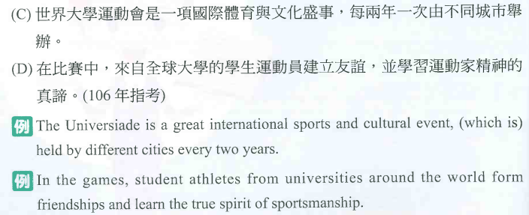
Sentence Structures
01

Slide 4
Sentence Structures
01

Slide 5
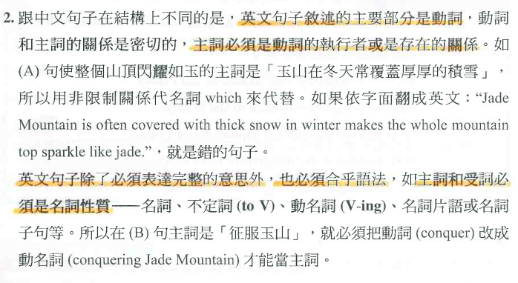
Sentence Structures
01

Slide 6
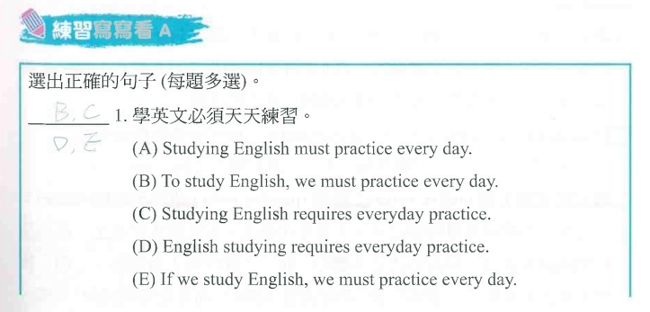
Sentence Structures
01

Slide 7
Sentence Structures
01

Slide 8
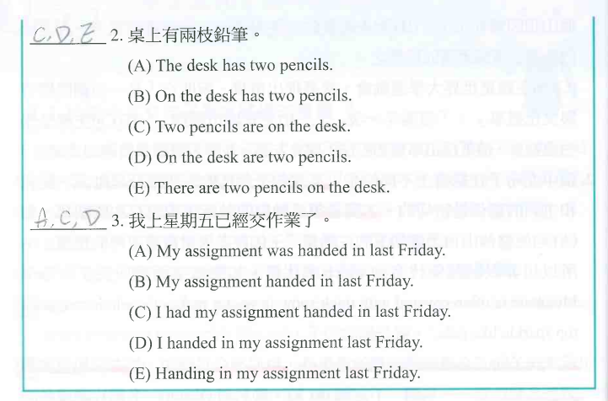
Sentence Structures
01

Slide 9
Sentence Structures
01

Slide 10
Sentence Structures
01

Slide 11
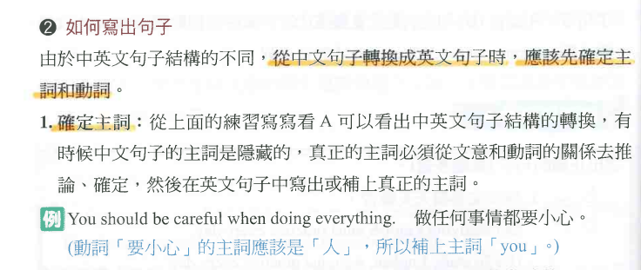
Sentence Structures
01

Slide 12
Sentence Structures
01

Slide 13
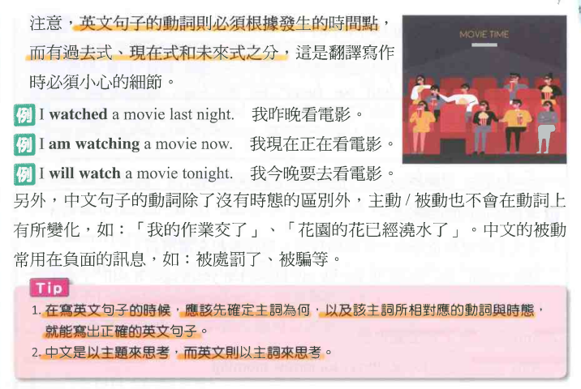
Sentence Structures
01

Slide 14
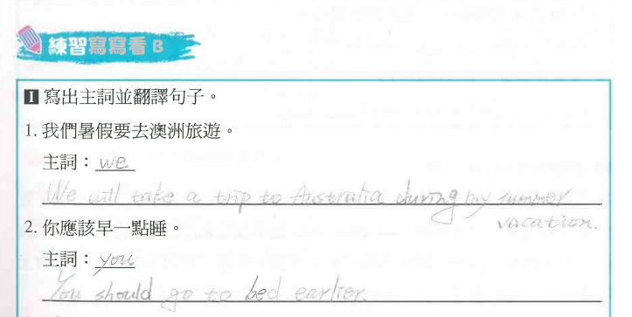
Sentence Structures
01

Slide 15
Sentence Structures
01

Slide 16
Sentence Structures
01

Slide 17
Sentence Structures
01

Slide 18
Sentence Structures
01

Slide 19
Sentence Structures
01

Slide 20
Sentence Structures
01

Slide 21
Sentence Structures
01

Slide 22
Sentence Structures
01

Slide 23
Sentence Structures
01

Slide 24
Sentence Structures
01

Slide 25
Sentence Structures
01

Slide 26
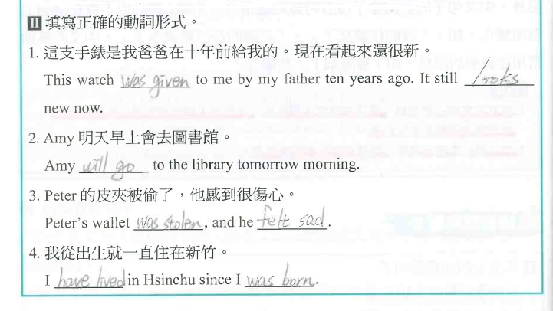
Sentence Structures
01

Slide 27
Sentence Structures
01

Slide 28
Sentence Structures
01

Slide 29
Sentence Structures
01

Slide 30
Sentence Structures
01

Slide 31
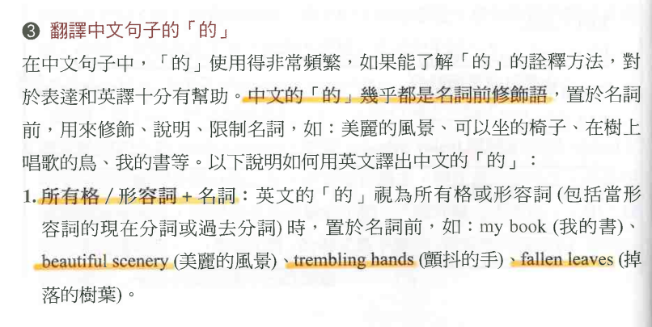
Sentence Structures
01

Slide 32
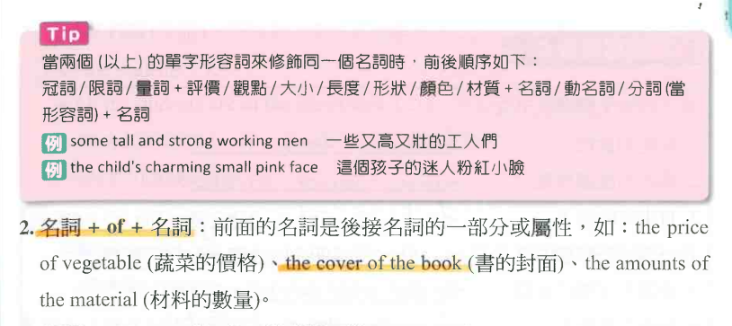
Sentence Structures
01

Slide 33
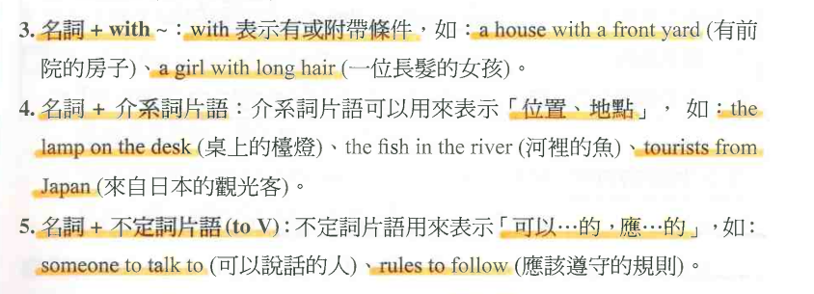
Sentence Structures
01

Slide 34
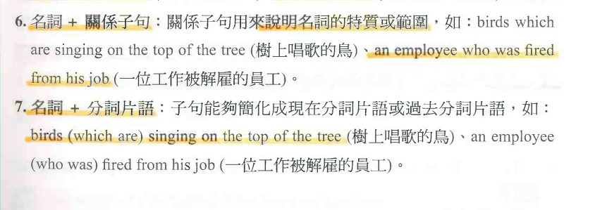
Sentence Structures
01

Slide 35
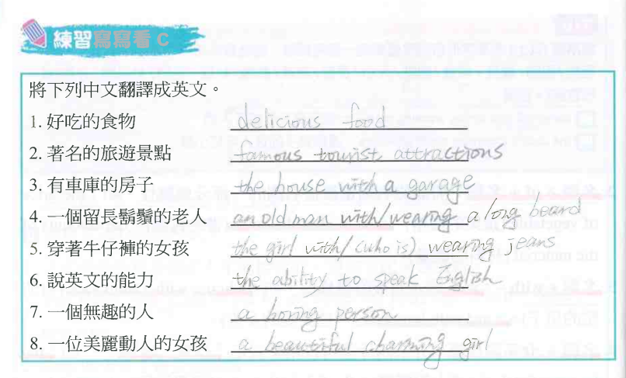
Sentence Structures
01

Slide 36
Sentence Structures
01

Slide 37
Sentence Structures
01

Slide 38
Sentence Structures
01

Slide 39
Sentence Structures
01

Slide 40
Sentence Structures
01

Slide 41
Sentence Structures
01

Slide 42
Sentence Structures
01

Slide 43
Sentence Structures
01

Slide 44
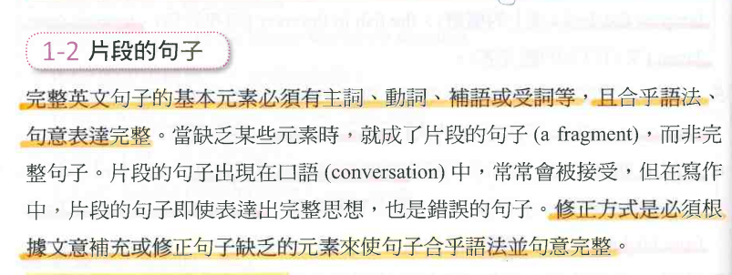
Sentence Structures
01

Slide 45
Sentence Structures
01

Slide 46
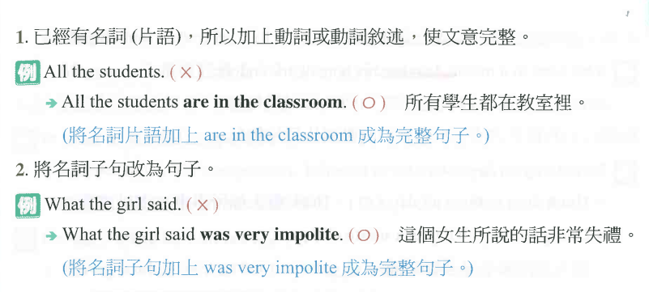
Sentence Structures
01

Slide 47
Sentence Structures
01

Slide 48
Sentence Structures
01

Slide 49
Sentence Structures
01

Slide 50
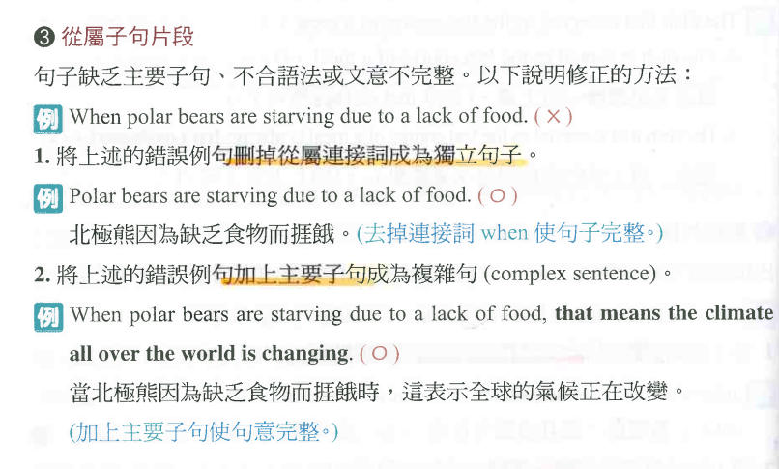
Sentence Structures
01

Slide 51
Sentence Structures
01

Slide 52
Sentence Structures
01

Slide 53
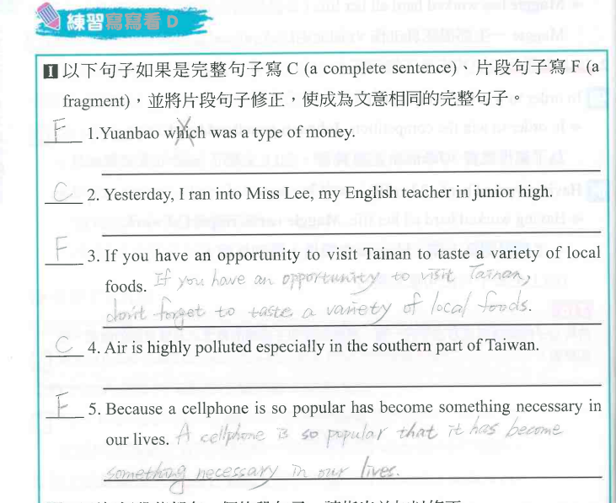
Sentence Structures
01

Slide 54
Sentence Structures
01

Slide 55
Sentence Structures
01

Slide 56
Sentence Structures
01

Slide 57
Sentence Structures
01

Slide 58
Sentence Structures
01

Slide 59
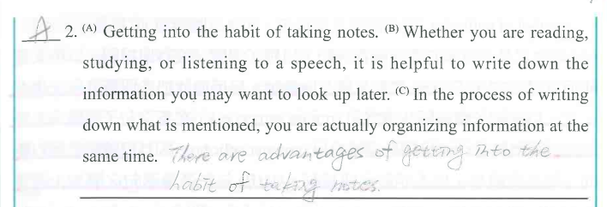
Sentence Structures
01

Slide 60
Sentence Structures
01

Slide 61
Sentence Structures
01

Slide 62
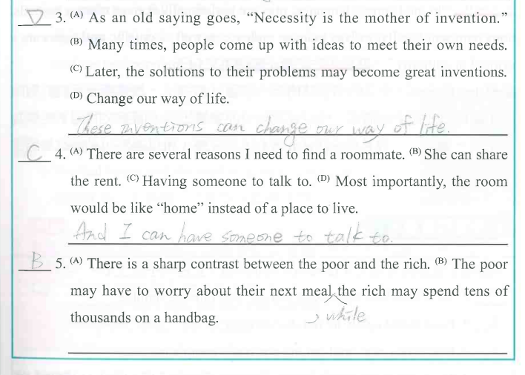
Sentence Structures
01

Slide 63
Sentence Structures
01

Slide 64
Sentence Structures
01

Slide 65
Sentence Structures
01

Slide 66
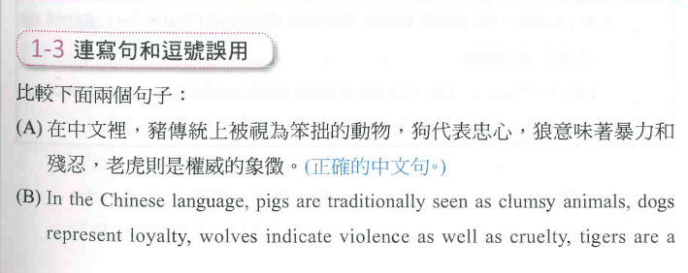
Sentence Structures
01

Slide 67
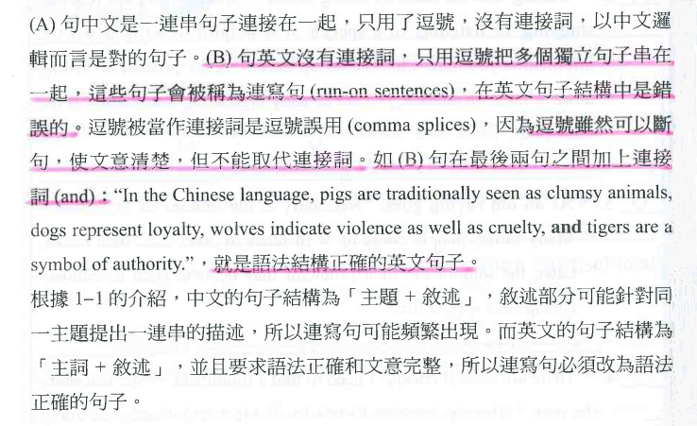
Sentence Structures
01

Slide 68
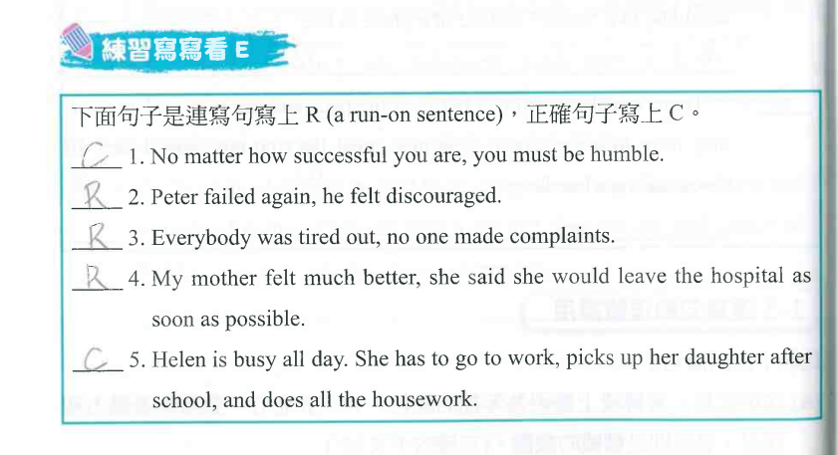
Sentence Structures
01

Slide 69
Sentence Structures
01

Slide 70
Sentence Structures
01

Slide 71
Sentence Structures
01

Slide 72
Sentence Structures
01

Slide 73
Sentence Structures
01

Slide 74
Sentence Structures
01

Slide 75
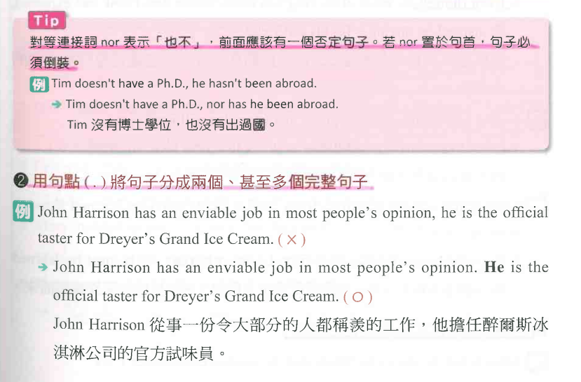
Sentence Structures
01

Slide 76
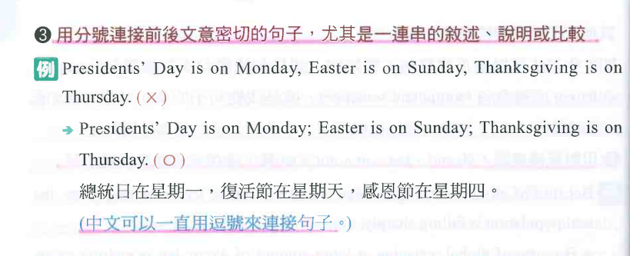
Sentence Structures
01

Slide 77
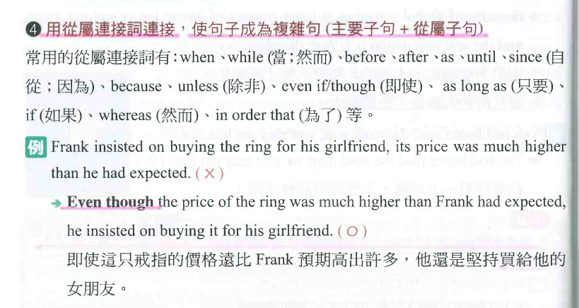
Sentence Structures
01

Slide 78
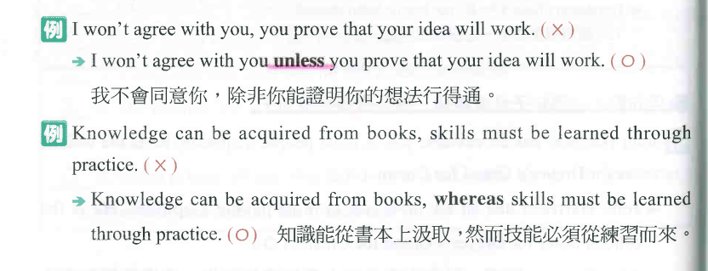
Sentence Structures
01

Slide 79
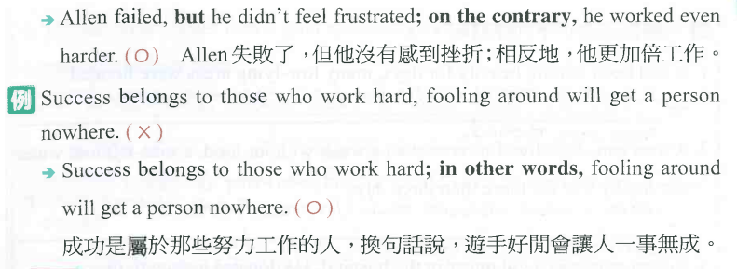
Sentence Structures
01

Slide 80
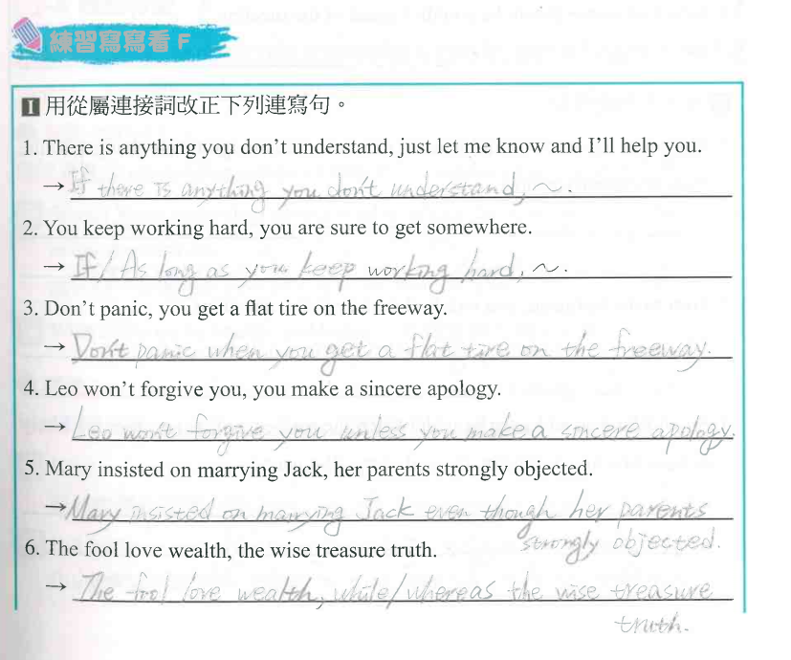
Sentence Structures
01

Slide 81
Sentence Structures
01

Slide 82
Sentence Structures
01

Slide 83
Sentence Structures
01

Slide 84
Sentence Structures
01

Slide 85
Sentence Structures
01

Slide 86
Sentence Structures
01

Slide 87
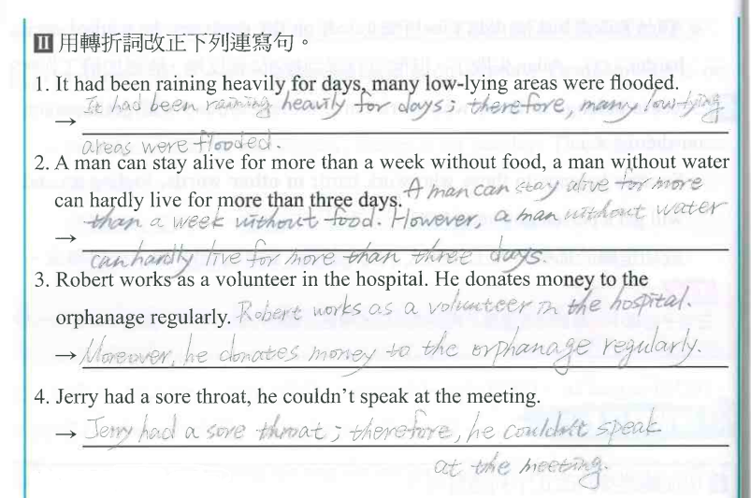
Sentence Structures
01

Slide 88
Sentence Structures
01

Slide 89
Sentence Structures
01

Slide 90
Sentence Structures
01

Slide 91
Sentence Structures
01

Slide 92
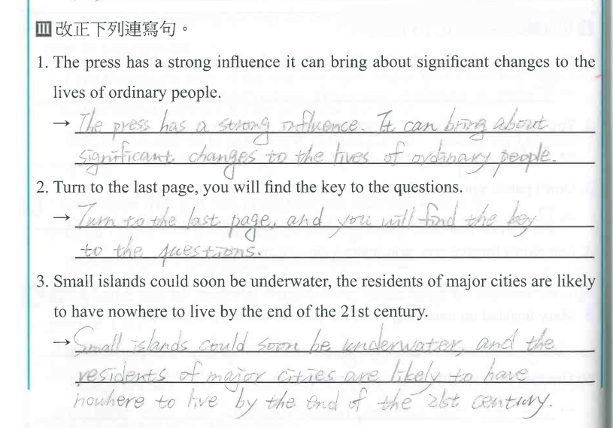
Sentence Structures
01

Slide 93
Sentence Structures
01

Slide 94
Sentence Structures
01

Slide 95
Sentence Structures
01

Slide 96
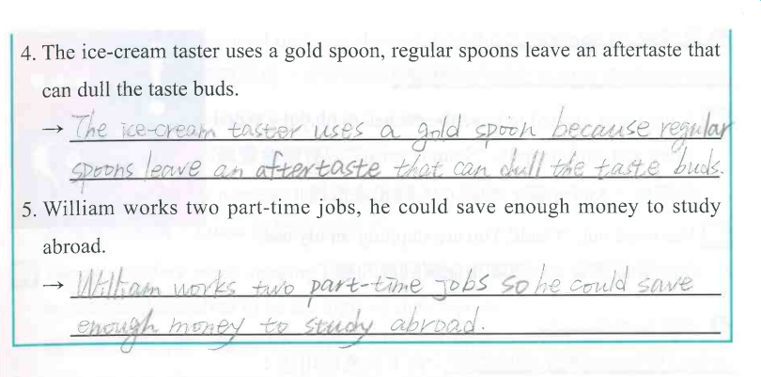
Sentence Structures
01

Slide 97
Sentence Structures
01

Slide 98
Sentence Structures
01

Slide 99
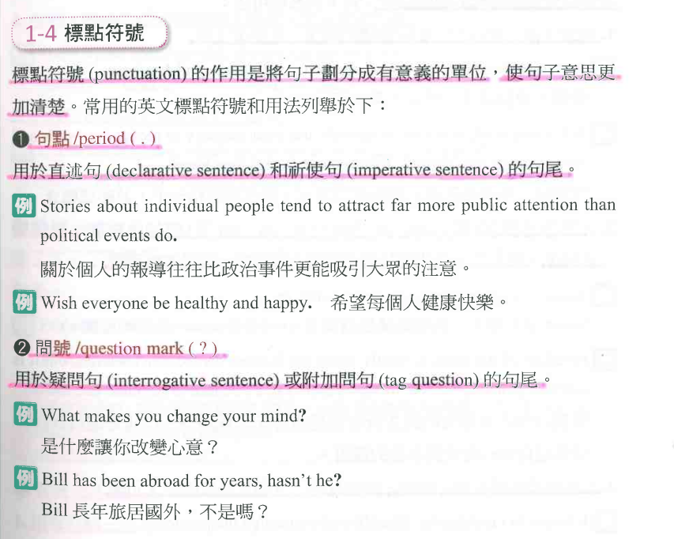
Sentence Structures
01

Slide 100
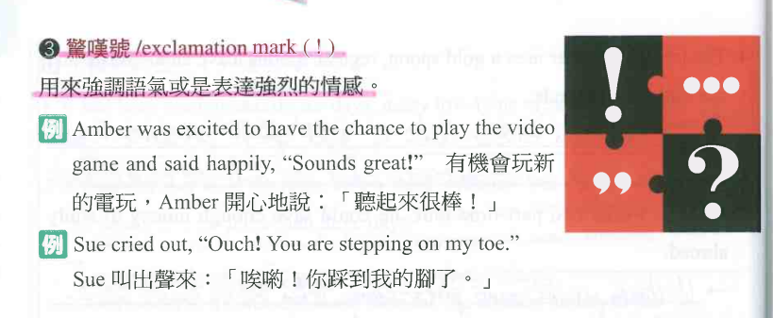
Sentence Structures
01

Slide 101
Sentence Structures
01

Slide 102
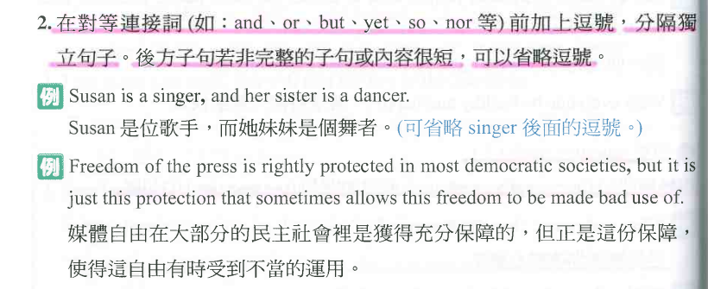
Sentence Structures
01

Slide 103
Sentence Structures
01

Slide 104
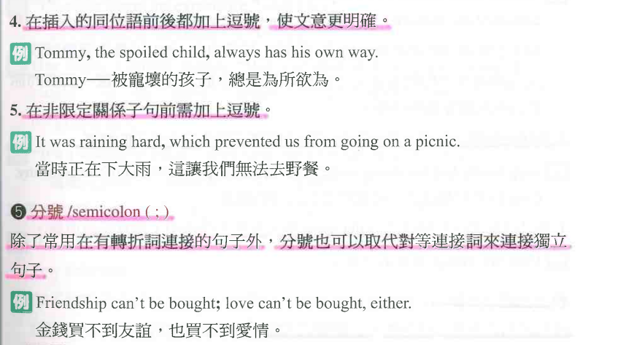
Sentence Structures
01

Slide 105
Sentence Structures
01

Slide 106
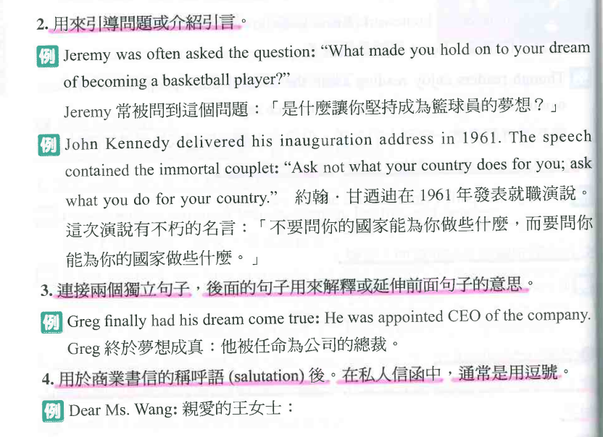
Sentence Structures
01

Slide 107
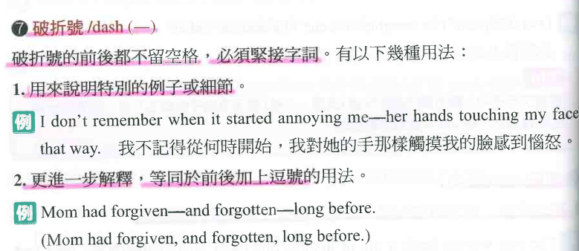
Sentence Structures
01

Slide 108
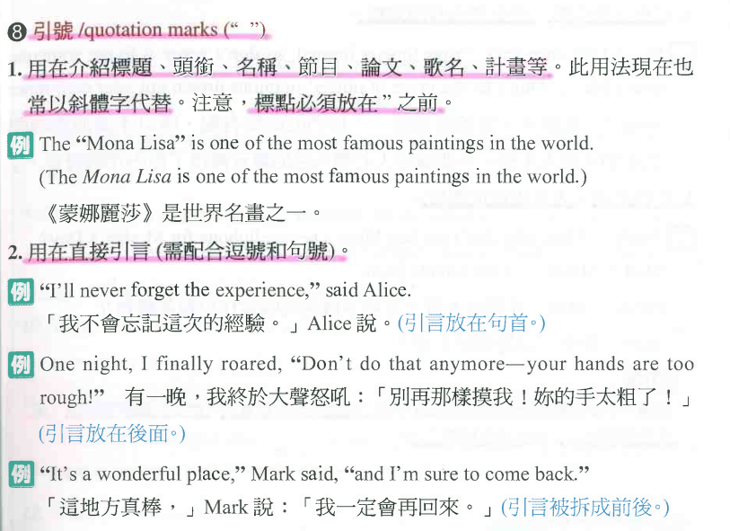
Sentence Structures
01

Slide 109
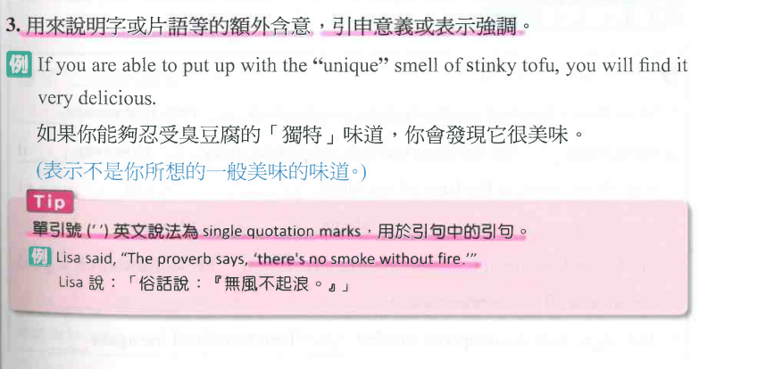
Sentence Structures
01

Slide 110
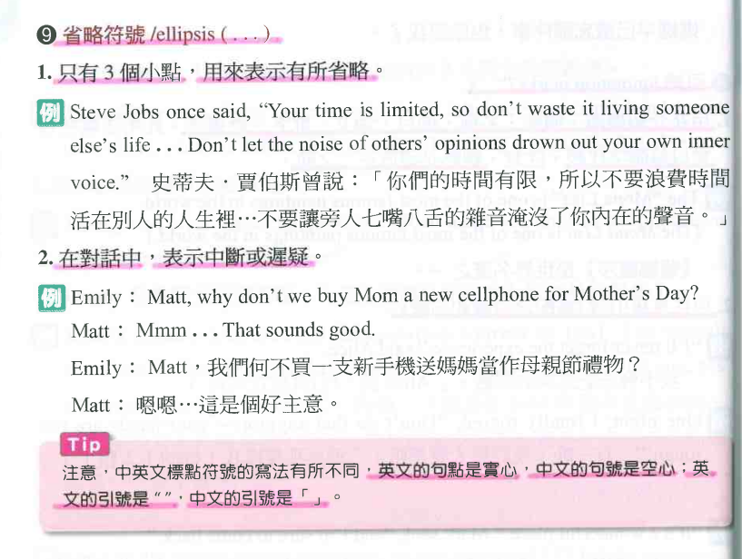
Sentence Structures
01

Slide 111
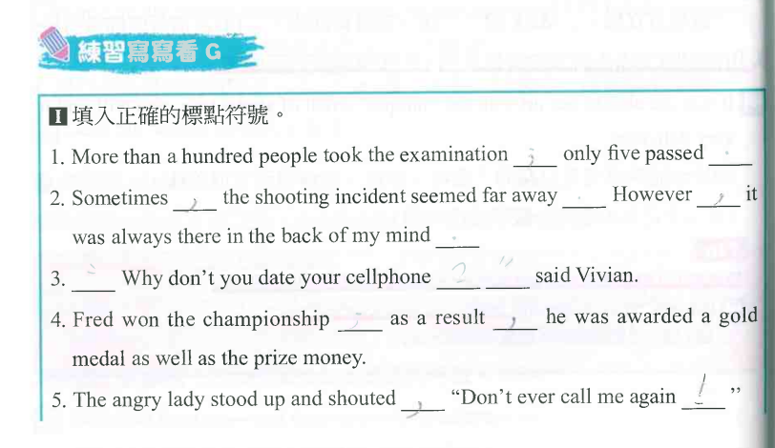
Sentence Structures
01

Slide 112
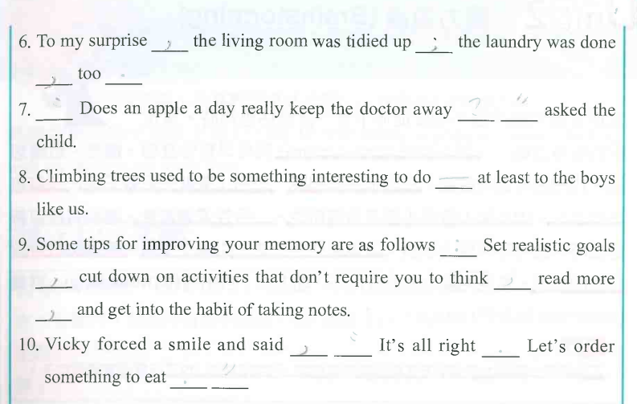
Sentence Structures
01

Slide 113
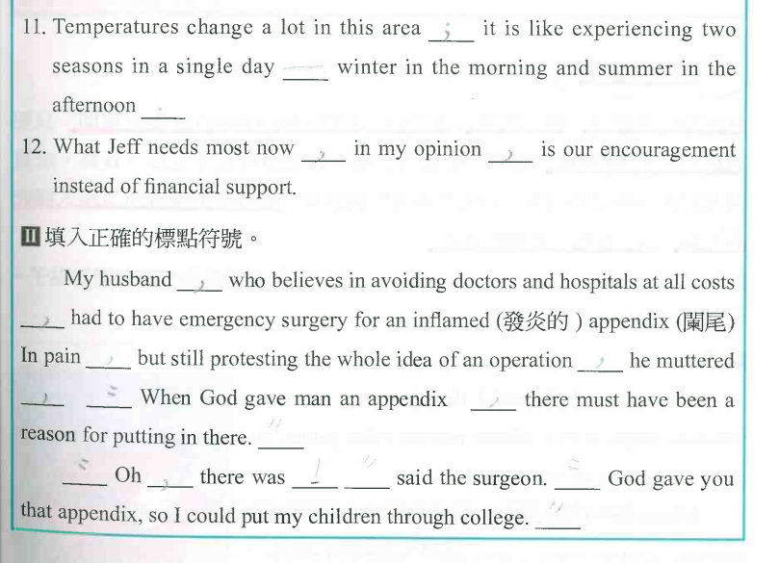
Sentence Structures
01

