Slide 1
English Writing

Slide 2
Sentence Structures
01

Slide 3
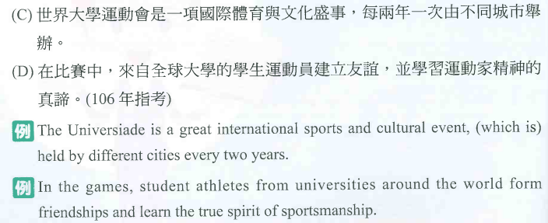
Sentence Structures
01

Slide 4
Sentence Structures
01

Slide 5
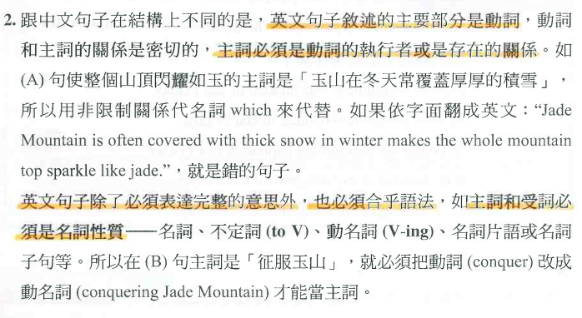
Sentence Structures
01

Slide 6
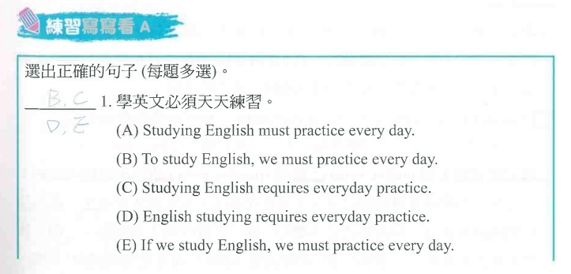
Sentence Structures
01

Slide 7
Sentence Structures
01

Slide 8
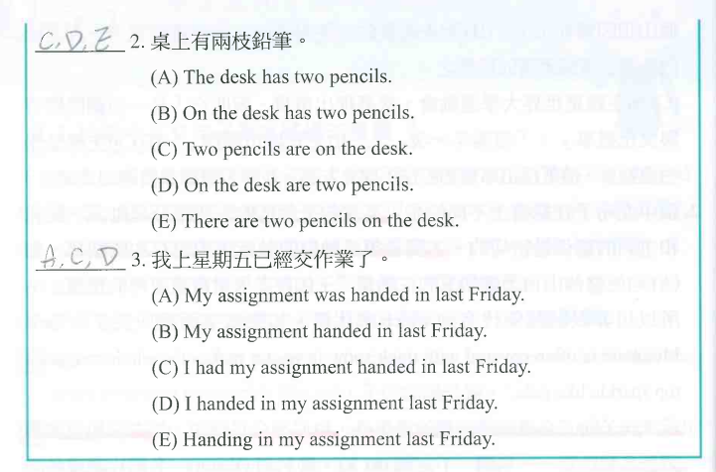
Sentence Structures
01

Slide 9
Sentence Structures
01

Slide 10
Sentence Structures
01

Slide 11
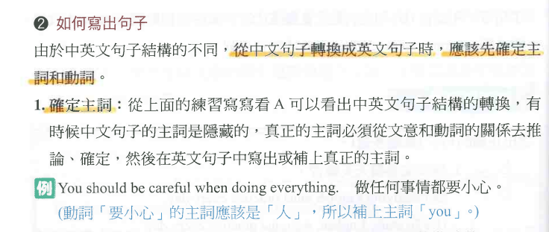
Sentence Structures
01

Slide 12
Sentence Structures
01

Slide 13
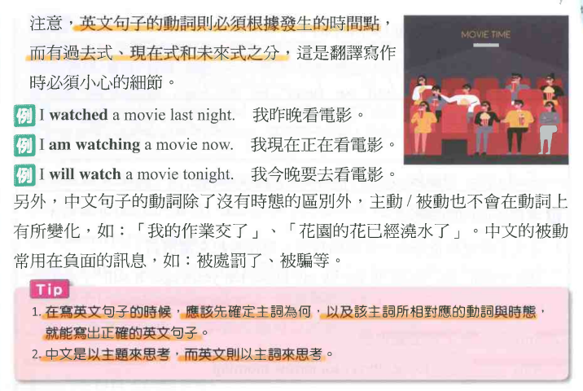
Sentence Structures
01

Slide 14
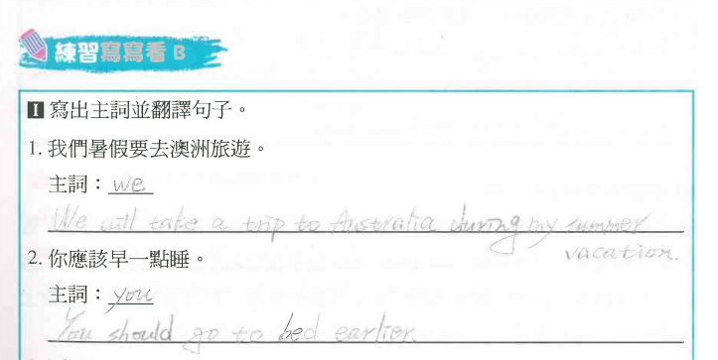
Sentence Structures
01

Slide 15
Sentence Structures
01

Slide 16
Sentence Structures
01

Slide 17
Sentence Structures
01

Slide 18
Sentence Structures
01

Slide 19
Sentence Structures
01

Slide 20
Sentence Structures
01

Slide 21
Sentence Structures
01

Slide 22
Sentence Structures
01

Slide 23
Sentence Structures
01

Slide 24
Sentence Structures
01

Slide 25
Sentence Structures
01

Slide 26
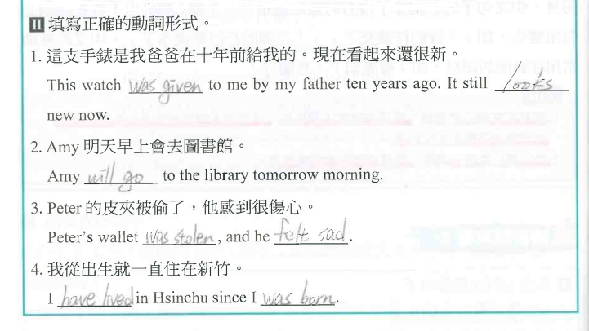
Sentence Structures
01

Slide 27
Sentence Structures
01

Slide 28
Sentence Structures
01

Slide 29
Sentence Structures
01

Slide 30
Sentence Structures
01

Slide 31
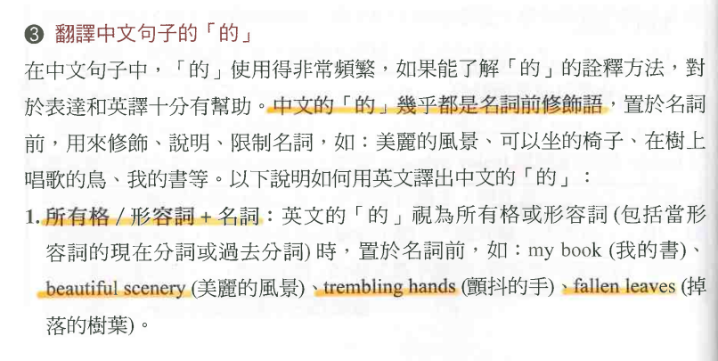
Sentence Structures
01

Slide 32
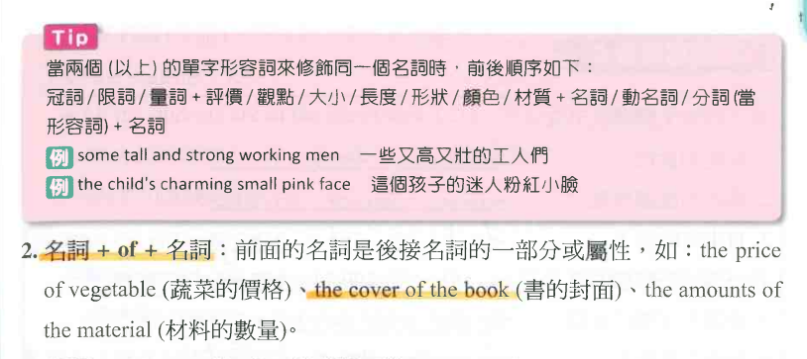
Sentence Structures
01

Slide 33
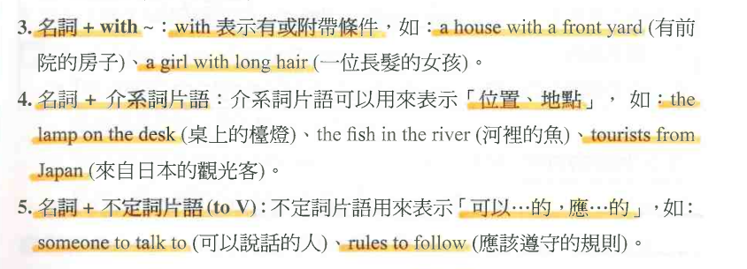
Sentence Structures
01

Slide 34
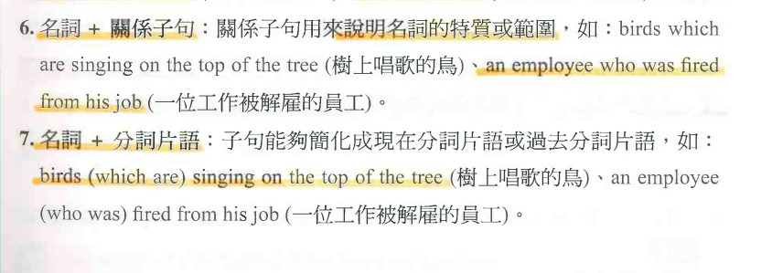
Sentence Structures
01

Slide 35
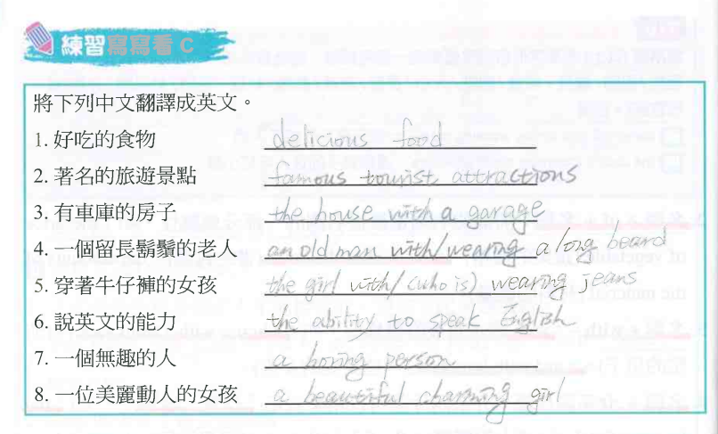
Sentence Structures
01

Slide 36
Sentence Structures
01

Slide 37
Sentence Structures
01

Slide 38
Sentence Structures
01

Slide 39
Sentence Structures
01

Slide 40
Sentence Structures
01

Slide 41
Sentence Structures
01

Slide 42
Sentence Structures
01

Slide 43
Sentence Structures
01

Slide 44
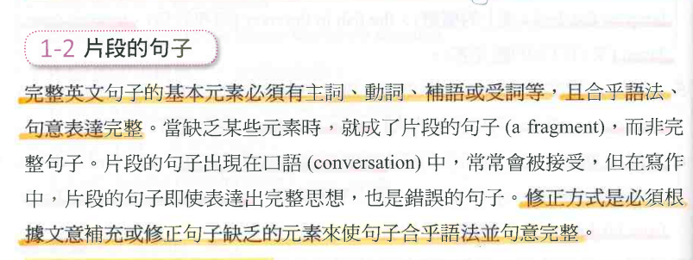
Sentence Structures
01

Slide 45
Sentence Structures
01

Slide 46
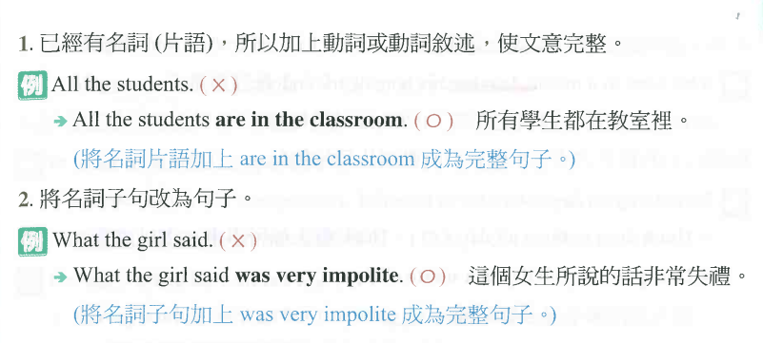
Sentence Structures
01

Slide 47
Sentence Structures
01

Slide 48
Sentence Structures
01

Slide 49
Sentence Structures
01

Slide 50
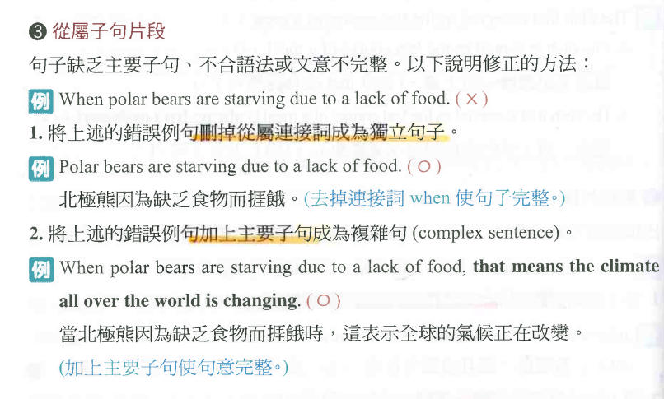
Sentence Structures
01

Slide 51
Sentence Structures
01

Slide 52
Sentence Structures
01

Slide 53
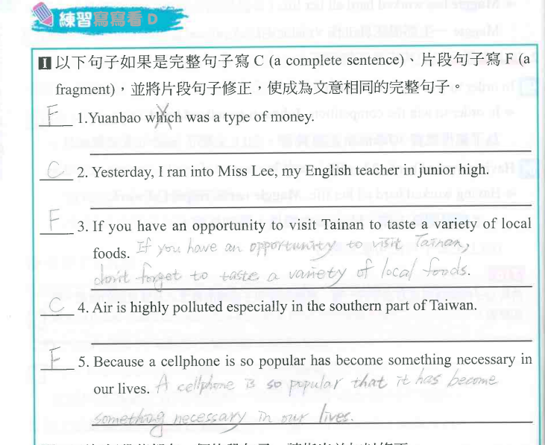
Sentence Structures
01

Slide 54
Sentence Structures
01

Slide 55
Sentence Structures
01

Slide 56
Sentence Structures
01

Slide 57
Sentence Structures
01

Slide 58
Sentence Structures
01

Slide 59
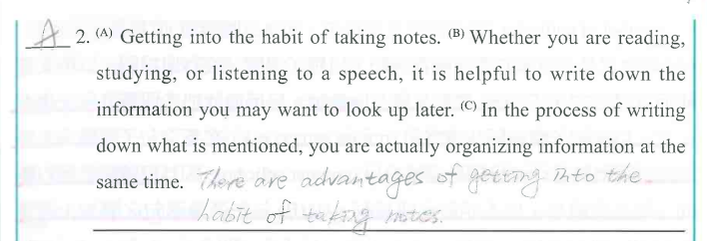
Sentence Structures
01

Slide 60
Sentence Structures
01

Slide 61
Sentence Structures
01

Slide 62
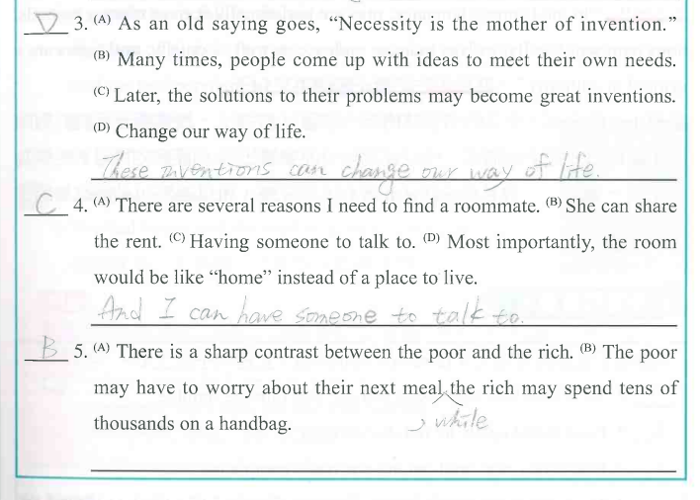
Sentence Structures
01

Slide 63
Sentence Structures
01

Slide 64
Sentence Structures
01

Slide 65
Sentence Structures
01

Slide 66
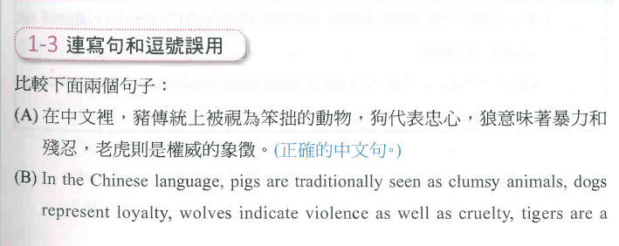
Sentence Structures
01

Slide 67
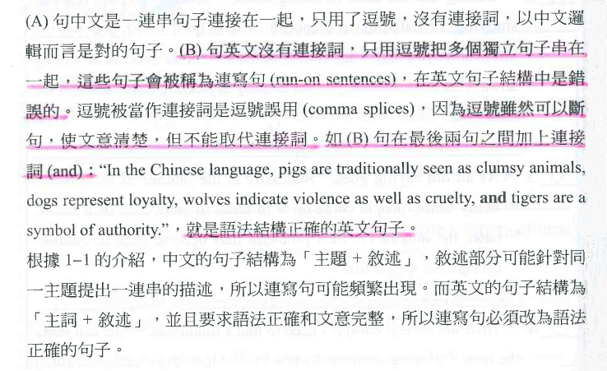
Sentence Structures
01

Slide 68
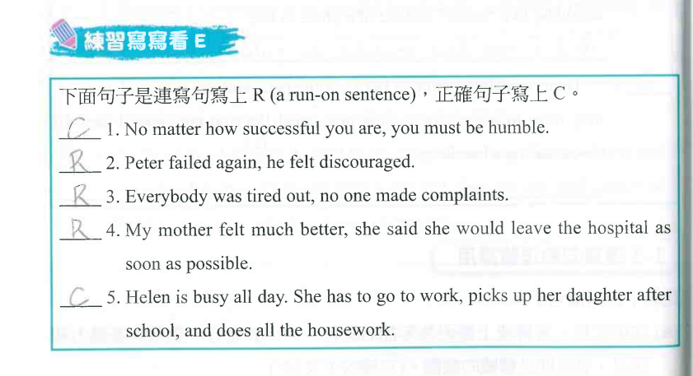
Sentence Structures
01

Slide 69
Sentence Structures
01

Slide 70
Sentence Structures
01

Slide 71
Sentence Structures
01

Slide 72
Sentence Structures
01

Slide 73
Sentence Structures
01

Slide 74
Sentence Structures
01

Slide 75
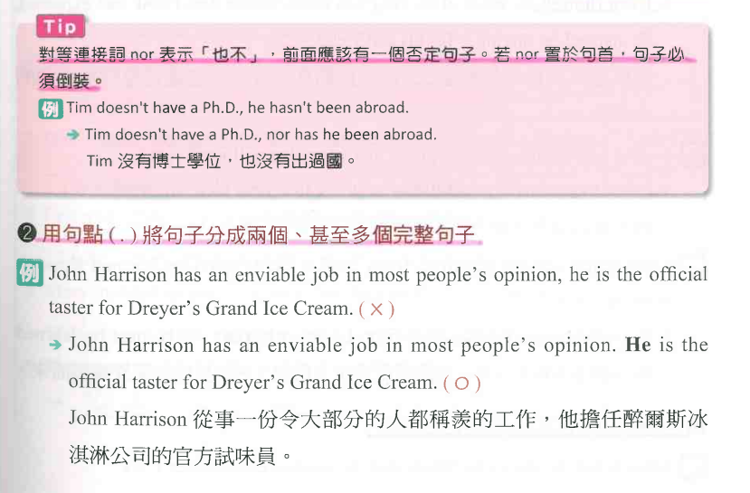
Sentence Structures
01

Slide 76
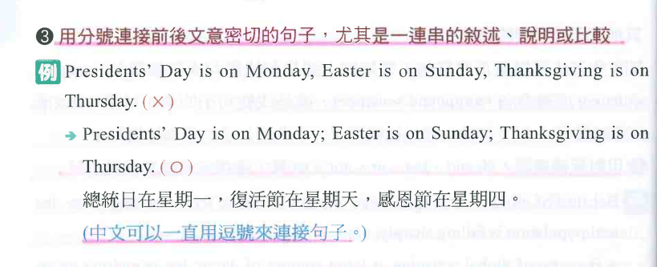
Sentence Structures
01

Slide 77
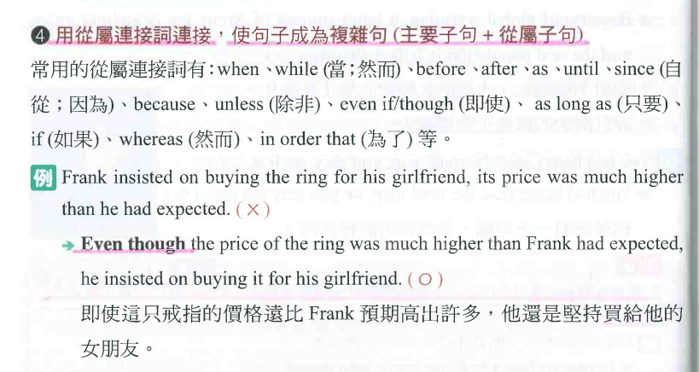
Sentence Structures
01

Slide 78
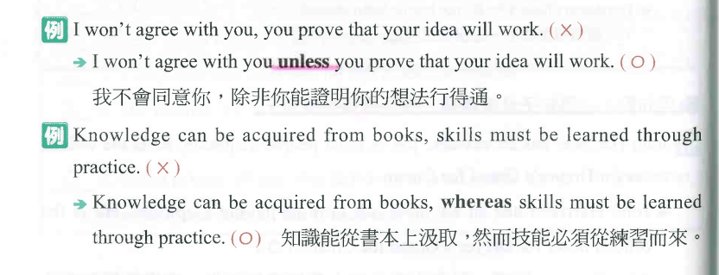
Sentence Structures
01

Slide 79
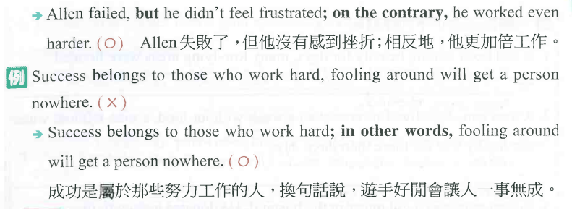
Sentence Structures
01

Slide 80
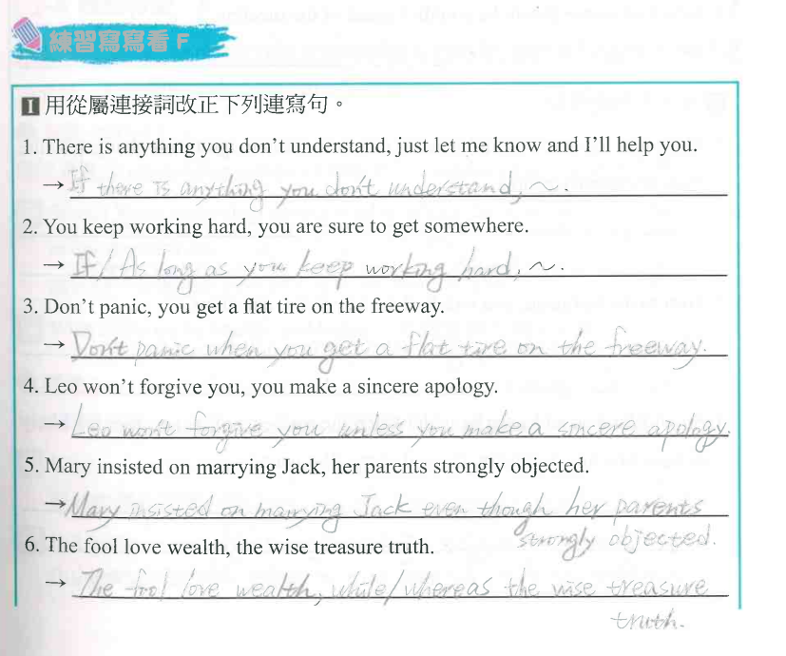
Sentence Structures
01

Slide 81
Sentence Structures
01

Slide 82
Sentence Structures
01

Slide 83
Sentence Structures
01

Slide 84
Sentence Structures
01

Slide 85
Sentence Structures
01

Slide 86
Sentence Structures
01

Slide 87
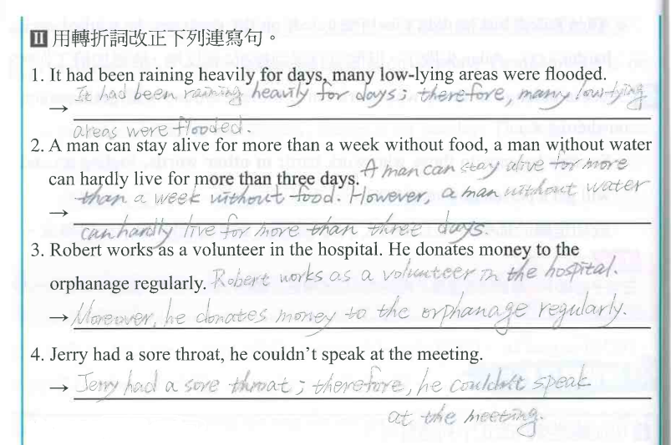
Sentence Structures
01

Slide 88
Sentence Structures
01

Slide 89
Sentence Structures
01

Slide 90
Sentence Structures
01

Slide 91
Sentence Structures
01

Slide 92
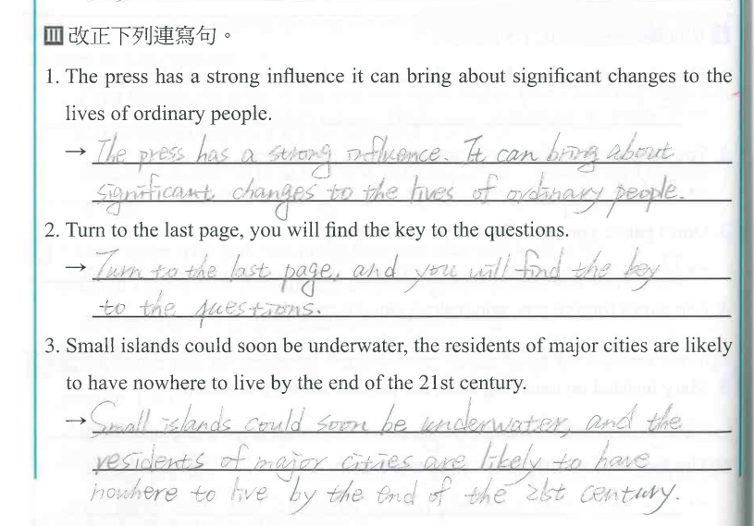
Sentence Structures
01

Slide 93
Sentence Structures
01

Slide 94
Sentence Structures
01

Slide 95
Sentence Structures
01

Slide 96
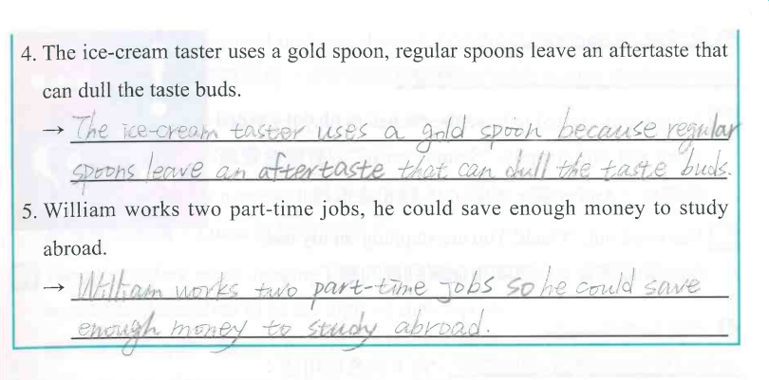
Sentence Structures
01

Slide 97
Sentence Structures
01

Slide 98
Sentence Structures
01

Slide 99
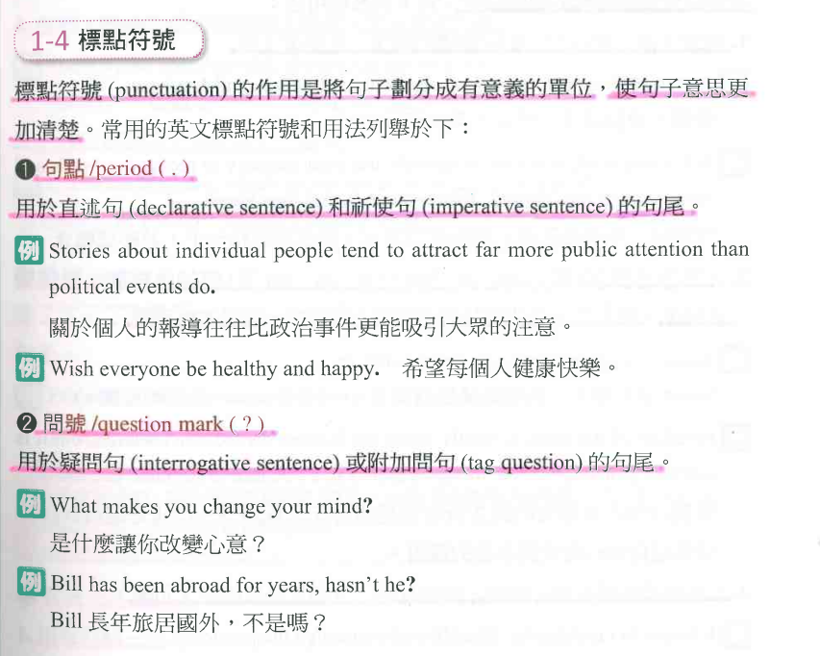
Sentence Structures
01

Slide 100
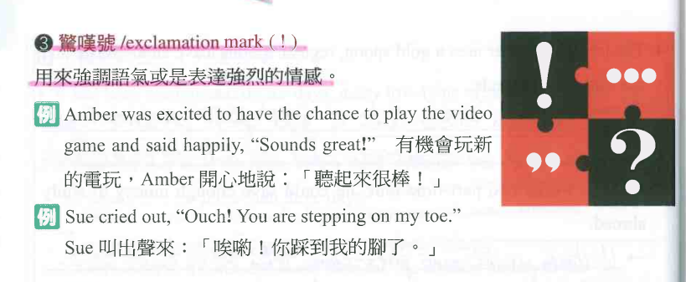
Sentence Structures
01

Slide 101
Sentence Structures
01

Slide 102
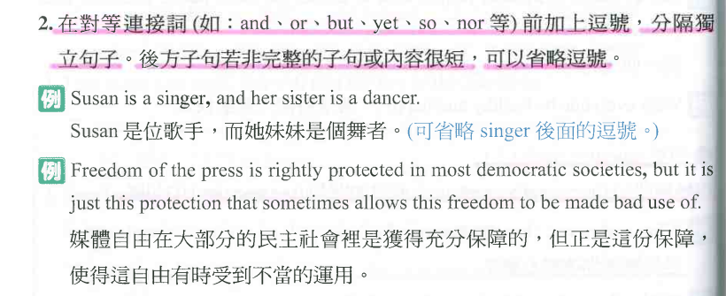
Sentence Structures
01

Slide 103
Sentence Structures
01

Slide 104
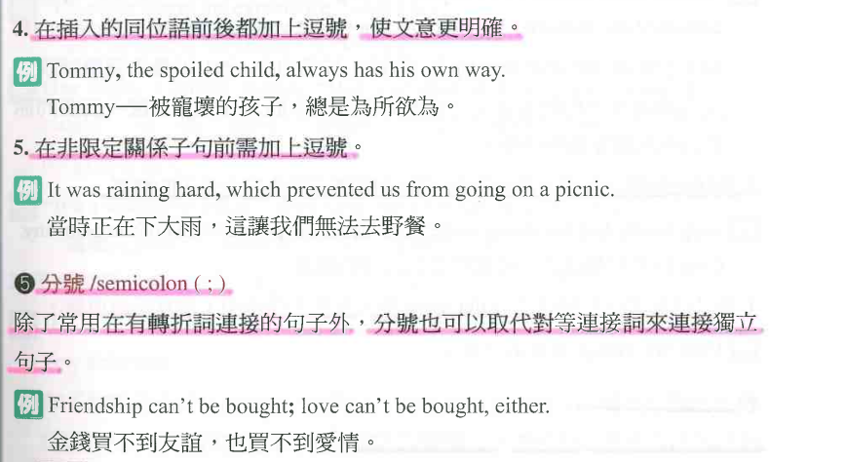
Sentence Structures
01

Slide 105
Sentence Structures
01

Slide 106
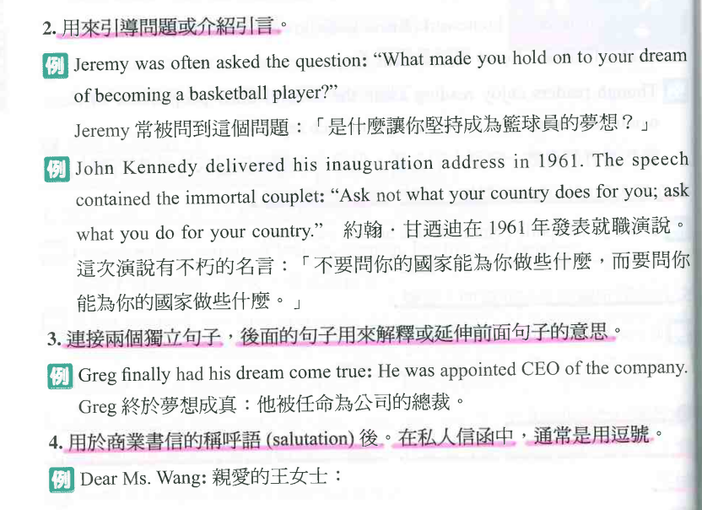
Sentence Structures
01

Slide 107
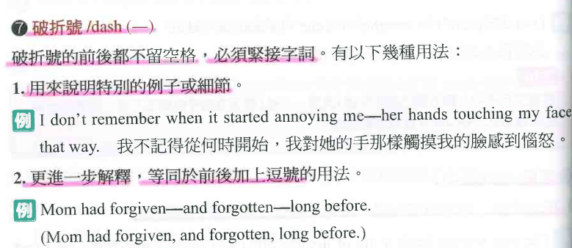
Sentence Structures
01

Slide 108
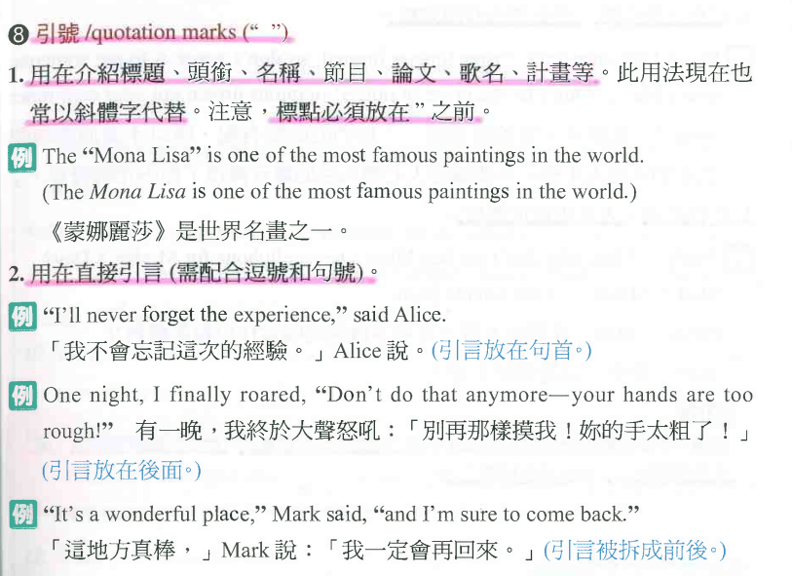
Sentence Structures
01

Slide 109
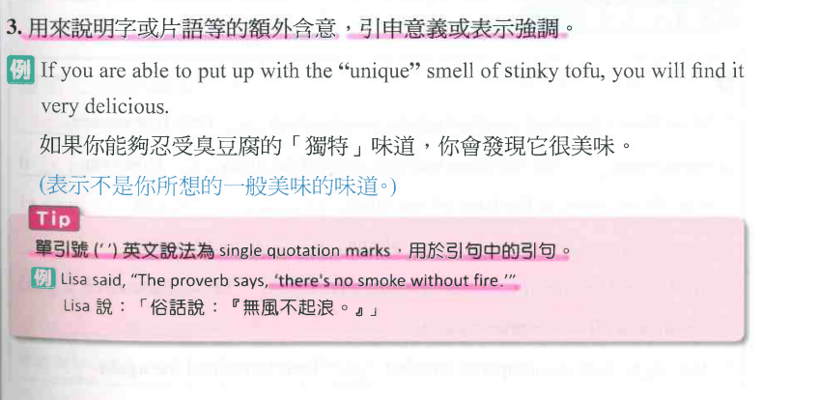
Sentence Structures
01

Slide 110
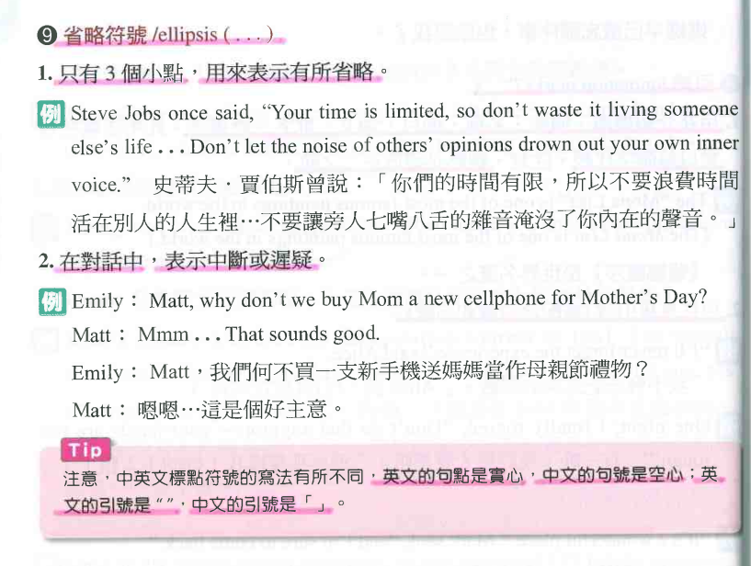
Sentence Structures
01

Slide 111
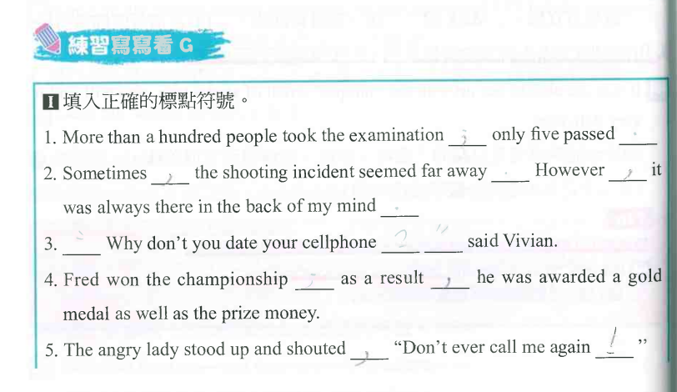
Sentence Structures
01

Slide 112
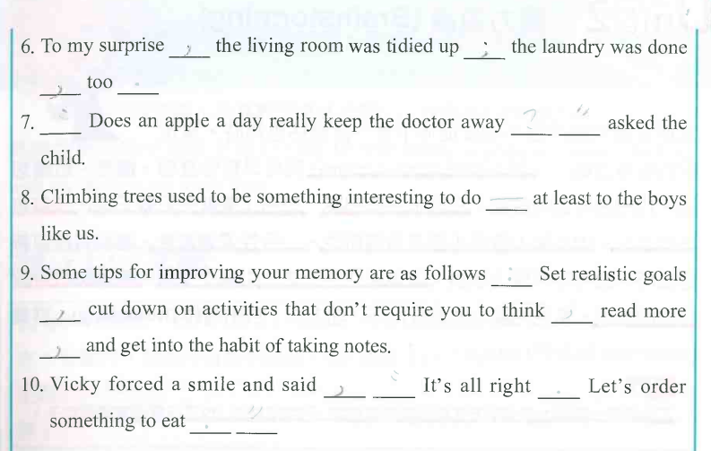
Sentence Structures
01

Slide 113
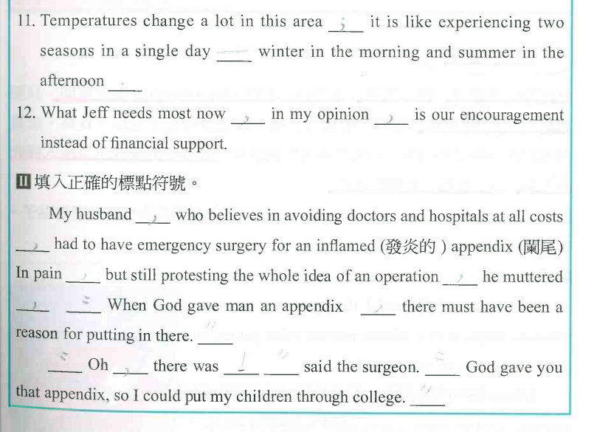
Sentence Structures
01

Slide 114
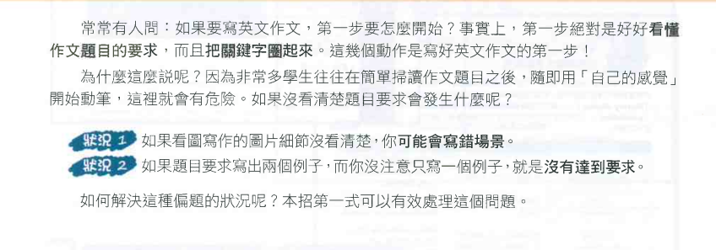
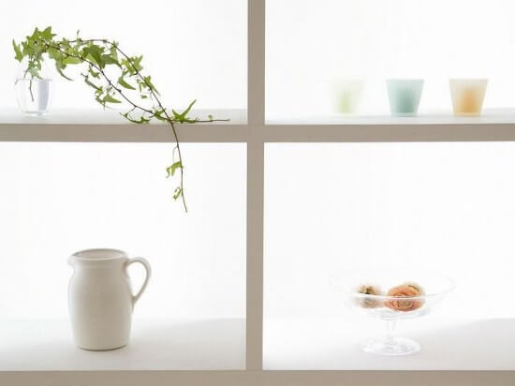
Topic & Outline
02

Slide 115
Topic & Outline
02

Slide 116
Topic & Outline
02

Slide 117
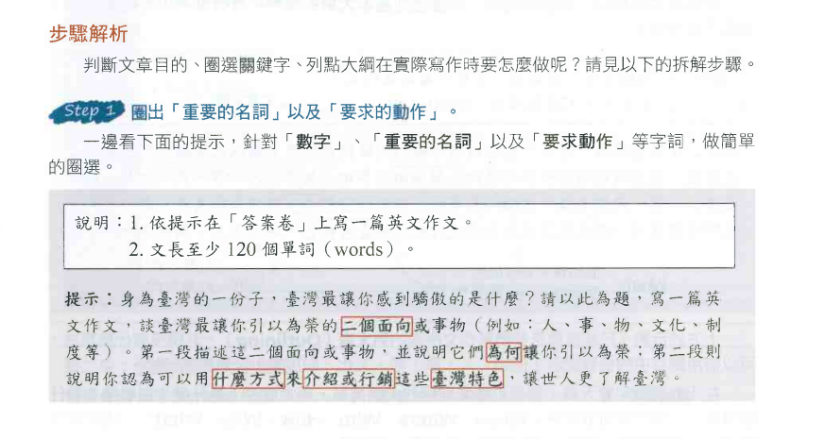
Topic & Outline
02

Slide 118
Topic & Outline
02

Slide 119
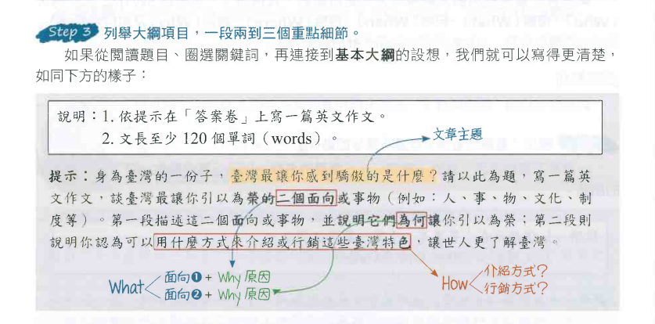
Topic & Outline
02

Slide 120
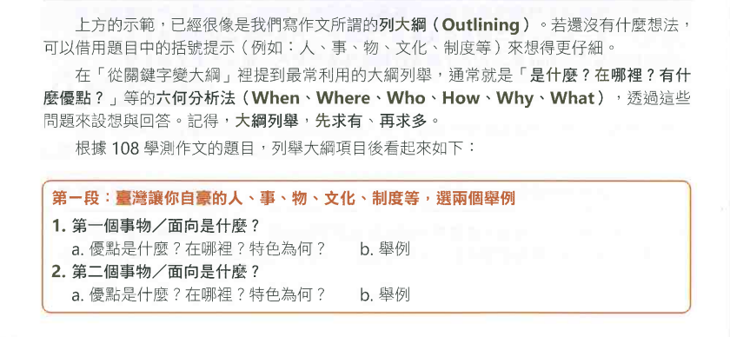
Topic & Outline
02

Slide 121
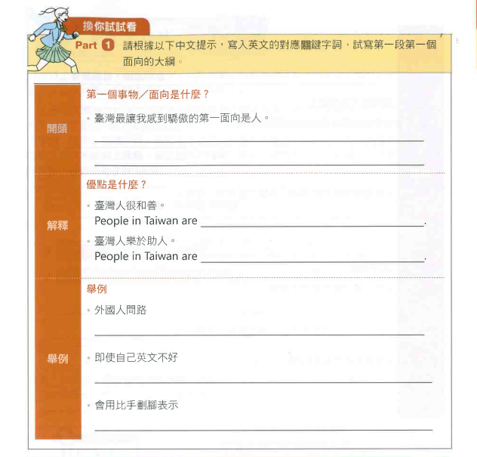
Topic & Outline
02

Slide 122
Topic & Outline
02
The aspect of Taiwan that I am most proud of is the people.

Slide 123
Topic & Outline
02
The aspect of Taiwan that I am most proud of is the people.
friendly

Slide 124
Topic & Outline
02
The aspect of Taiwan that I am most proud of is the people.
friendly
(more than) willing to help others

Slide 125
Topic & Outline
02
The aspect of Taiwan that I am most proud of is the people.
friendly
(more than) willing to help others
foreigners ask for directions

Slide 126
Topic & Outline
02
The aspect of Taiwan that I am most proud of is the people.
friendly
(more than) willing to help others
foreigners ask for directions
although his/her English is poor

Slide 127
Topic & Outline
02
The aspect of Taiwan that I am most proud of is the people.
friendly
(more than) willing to help others
foreigners ask for directions
although his/her English is poor
use body language to express

Slide 128
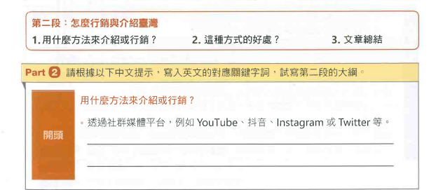
Topic & Outline
02

Slide 129
Topic & Outline
02
We can use social media platforms, such as YouTube, TikTok, Instgram, or Twitter.

Slide 130
Topic & Outline
02
We can use social media platforms, such as YouTube, TikTok, Instgram, or Twitter.
We can invite KOLs (Key Opinion Leaders) to Taiwan and make short video clips introducing Taiwan.

Slide 131
Topic & Outline
02
總結

Slide 132
Topic & Outline
02
The transmission on social media platforms is fast and has no geographical limits.
總結

Slide 133
Topic & Outline
02
The transmission on social media platforms is fast and has no geographical limits.
The influence of foreign KOLs is much deeper, wider, and more effective.
總結

Slide 134
Topic & Outline
02
The transmission on social media platforms is fast and has no geographical limits.
The influence of foreign KOLs is much deeper, wider, and more effective.
We will use a combination of traditional advertising and social media.
總結

Slide 135
Topic & Outline
02
The transmission on social media platforms is fast and has no geographical limits.
The influence of foreign KOLs is much deeper, wider, and more effective.
We will use a combination of traditional advertising and social media.
總結
More and more people will fall in love with Taiwan.

Slide 136
Topic & Outline
02

Slide 137
Topic & Outline
02

Slide 138
Topic & Outline
02

Slide 139
Topic & Outline
02

Slide 140
Topic & Outline
02

Slide 141
Topic & Outline
02

Slide 142
Topic & Outline
02

Slide 143
Topic & Outline
02

Slide 144
Topic & Outline
02

Slide 145
Topic & Outline
02

Slide 146
Topic & Outline
02

Slide 147
Topic & Outline
02

Slide 148
Topic & Outline
02

Slide 149
Topic & Outline
02

Slide 150
Topic & Outline
02

Slide 151
Topic & Outline
02
Sample Article ~ 1-1
Eating tasty food often creates happy memories. I have enjoyed many delicacies, but one uniquely impressive dish that stands out to me is chili crabs. This dish offers an amazing blend of flavors.

Slide 152
Topic & Outline
02
Sample Article ~ 1-2
The crab meat, which is tender and juicy, is coated in a mix of spicy, sweet, and tangy chili sauce, creating a culinary experience like no other. Though eating chili crabs can be a bit messy, the pleasure of savoring them is always worth it.

Slide 153
Topic & Outline
02
Sample Article ~ 1-3
I was introduced to chili crabs on my first trip abroad with my family to Singapore when I was 15 years old. At first, my brother and I weren’t sure how to eat this dish as the crabs were served with their shells on.

Slide 154
Topic & Outline
02
Sample Article ~ 1-4
However, instructed step by step by our parents, we managed to crack them open and enjoyed the crab meat a lot. Though the process was a bit messy, those chili crabs turned out to be more than just a meal.

Slide 155
Topic & Outline
02
Sample Article ~ 1-5
They were a family experience, something we have recalled for years. I can still remember how messy and funny we were when we were trying to crack the crab open. This dish acts like a time machine, never failing to transport me back to that special moment.

Slide 156
Topic & Outline
02
Sample Article ~ 2-1
Unforgettable foods are like bookmarks in the chapters of our lives, with each flavor acting as a trigger for recollections, allowing us to revisit unique moments. For me, banana bread stands out as one such memorable treat.

Slide 157
Topic & Outline
02
Sample Article ~ 2-2
This mouth-watering, golden-brown treat has a soft, fluffy, and moist texture. It also has natural sweetness from ripe bananas, which sets it apart from other pastries with added sugar.

Slide 158
Topic & Outline
02
Sample Article ~ 2-3
Additionally, its distinctive aroma adds another layer to the sensory delight, making banana bread a treat for the eyes, nose, and taste buds.

Slide 159
Topic & Outline
02
Sample Article ~ 2-4
During my freshman year of junior high, I took my very first baking adventure: making banana bread. The preparation was chaotic because I had spent quite some time distinguishing, measuring, and mixing every ingredient. Overwhelmed yet excited, I felt like I was uncovering a secret world.

Slide 160
Topic & Outline
02
Sample Article ~ 2-5
As the tempting aroma of sweet bananas drifted all over the house, I eagerly anticipated the magic happening inside the oven and the moment of triumph. I shared the homemade bread with my beloved family, who showed their enthusiastic fondness as they devoured it with nonstop exclamations.

Slide 161
Topic & Outline
02
Sample Article ~ 2-6
At that unforgettable moment, I realized that food is a language of love. Now, years later, as I recall that day and the banana bread, I can still vividly feel it telling a story of shared moments and cherished connections.

Slide 162
Topic & Outline
02

Slide 163
Topic & Outline
02

Slide 164
Topic & Outline
02

Slide 165
Topic & Outline
02

Slide 166
Topic & Outline
02

Slide 167
Topic & Outline
02

Slide 168
Topic & Outline
02

Slide 169
Topic & Outline
02

Slide 170
Topic & Outline
02

Slide 171
Topic & Outline
02

Slide 172
Topic & Outline
02

Slide 173
Topic & Outline
02

Slide 174
Topic & Outline
02

Slide 175
Topic & Outline
02

Slide 176
Topic & Outline
02
D
B
E

Slide 177
Topic & Outline
02

Slide 178
Topic & Outline
02

Slide 179
Topic & Outline
02

Slide 180
Topic & Outline
02
C
B
A

Slide 181
Topic & Outline
02

Slide 182
Topic & Outline
02
B
A
C

Slide 183
Topic & Outline
02

Slide 184
Topic & Outline
02

Slide 185
Topic & Outline
02

Slide 186
Topic & Outline
02

Slide 187
Topic & Outline
02

Slide 188
Topic & Outline
02
children
there is a playground with recreational equipment for kids

Slide 189
Topic & Outline
02
children
there is a playground with recreational equipment for kids
colorful slides
tunnels
monkey bars

Slide 190
Topic & Outline
02
children
there is a playground with recreational equipment for kids
colorful slides
tunnels
monkey bars
the ground is covered with black cushions,
which makes it safer for kids to play in the park

Slide 191
Topic & Outline
02

Slide 192
Topic & Outline
02
its natural scenery
greenery lovers or people who enjoy outdoor
activities in nature

Slide 193
Topic & Outline
02
its natural scenery
greenery lovers or people who enjoy outdoor
activities in nature
a lot of trees providing shade
an open meadow where people can picnic or play catch

Slide 194
Topic & Outline
02
its natural scenery
greenery lovers or people who enjoy outdoor
activities in nature
a lot of trees providing shade
an open meadow where people can picnic or play catch
enjoy the breeze and the song of birds,
which helps release stress by giving people a break from the hustle and bustle of life

Slide 195
Topic & Outline
02
its natural scenery
greenery lovers or people who enjoy outdoor
activities in nature
a lot of trees providing shade
an open meadow where people can picnic or play catch
enjoy the breeze and the song of birds,
which helps release stress by giving people a break from the hustle and bustle of life
energetic children
play
nature enthusiasts
enjoy quality time in serenity

Slide 196
Topic & Outline
02

Slide 197
Topic & Outline
02
must have a high level of cleanliness
and facilities, and most importantly, it should be close to home.

Slide 198
Topic & Outline
02

Slide 199
Topic & Outline
02
Cleanliness
A space with clean grounds and clean washrooms makes people feel comfortable.

Slide 200
Topic & Outline
02
Cleanliness
A space with clean grounds and clean washrooms makes people feel comfortable.
Sports facilities
A park like this encourages active lifestyles and brings health benefits.

Slide 201
Topic & Outline
02
Cleanliness
A space with clean grounds and clean washrooms makes people feel comfortable.
Sports facilities
A park like this encourages active lifestyles and brings health benefits.
be just around the corner.
The green space not only makes a neighborhood more enjoyable to walk through but also provides opportunities for social interaction.

Slide 202
Topic & Outline
02

Slide 203
Topic & Outline
02
should be tidy, well-equipped
and easily reachable. If people want to find a good neighborhood to live in, they should check out the qualities of the nearest park.

Slide 204
Topic & Outline
02

Slide 205
Narrative & Exposition
03

Slide 206
Narrative & Exposition
03

Slide 207
Narrative & Exposition
03

Slide 208
Narrative & Exposition
03

Slide 209
Narrative & Exposition
03

Slide 210
Narrative & Exposition
03

Slide 211
Narrative & Exposition
03
E
C
D
B
A

Slide 212
Narrative & Exposition
03

Slide 213
Narrative & Exposition
03

Slide 214
Narrative & Exposition
03

Slide 215
Narrative & Exposition
03

Slide 216
Narrative & Exposition
03

Slide 217
Narrative & Exposition
03
F
I
G
H
E

Slide 218
Narrative & Exposition
03

Slide 219
Narrative & Exposition
03

Slide 220
Narrative & Exposition
03

Slide 221
Narrative & Exposition
03

Slide 222
Narrative & Exposition
03

Slide 223
Narrative & Exposition
03
anniversary sale

Slide 224
Narrative & Exposition
03
anniversary sale
Anna went shopping with her kids.

Slide 225
Narrative & Exposition
03
anniversary sale
Shouting, pushing, excited, panicked
Anna went shopping with her kids.

Slide 226
Narrative & Exposition
03
anniversary sale
Shouting, pushing, excited, panicked
Anna went shopping with her kids.
People fought for special deals offered to the first hundred customers.

Slide 227
Narrative & Exposition
03
anniversary sale
Shouting, pushing, excited, panicked
Anna went shopping with her kids.
People fought for special deals offered to the first hundred customers.
Anna lost her kids in the crowd. She ran around looking for them.

Slide 228
Narrative & Exposition
03

Slide 229
Narrative & Exposition
03

Slide 230
Narrative & Exposition
03

Slide 231
Narrative & Exposition
03

Slide 232
Narrative & Exposition
03
Anna and her kids were standing in the crowd in front of a department store. It was the first day of the anniversary sale.

Slide 233
Narrative & Exposition
03
Anna and her kids were standing in the crowd in front of a department store. It was the first day of the anniversary sale.
The moment the doors were open, the crowd rushed through the doors. Soon the first floor was filled with hundreds of people.

Slide 234
Narrative & Exposition
03
In the cosmetics section, salesmen and saleswomen were shouting, and customers were pushing one another. Anna was one of them. She wanted to be one of the first hundred customers to get the special deal. She was so excited that she didn’t realize her kids were no longer by her side. When she finally had what she wanted in hand and couldn’t see her kids, she panicked. Anna ran around, looking for her kids.

Slide 235
Narrative & Exposition
03
Suddenly, she heard the broadcast announcing that two lost children had been found and taken to the information center.

Slide 236
Narrative & Exposition
03
Suddenly, she heard the broadcast announcing that two lost children had been found and taken to the information center.
Anna ran to the information center and to her relief, the kids were safe and sound. She was happy to get her kids back and learned to be more careful next time.

Slide 237
Narrative & Exposition
03

Slide 238
Narrative & Exposition
03

Slide 239
Narrative & Exposition
03

Slide 240
Narrative & Exposition
03

Slide 241
Narrative & Exposition
03

Slide 242
Narrative & Exposition
03

Slide 243
Narrative & Exposition
03

Slide 244
Narrative & Exposition
03

Slide 245
Narrative & Exposition
03

Slide 246
Narrative & Exposition
03
Sample Article ~ 2-1
One sunny afternoon, while enjoying a peaceful walk in the city, I found the sole of my shoe detached from the rest. Realizing the shoe was irreparable, I had no choice but to purchase a new pair.

Slide 247
Narrative & Exposition
03
Sample Article ~ 2-2
That night, while I browsed stores online, I stumbled upon a post in a social media community, where someone was selling the hottest NB sneakers for an incredible NT$1,999.

Slide 248
Narrative & Exposition
03
Sample Article ~ 2-3
This was way cheaper than the NT$3,999 price I had seen in a physical store. Tempted by the opportunity to own fantastic shoes without denting my wallet, I ordered a pair without a second thought.

Slide 249
Narrative & Exposition
03
Sample Article ~ 2-4
Days later, the much-anticipated shoes arrived. My excitement turned into disbelief, though, as I discovered the “B” in the logo was reversed—a clear sign of counterfeit merchandise.

Slide 250
Narrative & Exposition
03
Sample Article ~ 2-5
Refusing to accept this situation passively, I gathered evidence and began sending complaint messages to the seller. Nevertheless, my efforts were in vain because the scammer seemed to disappear without a trace, and the account was terminated.

Slide 251
Sample Article ~ 2-6
Narrative & Exposition
03
It appeared that there was no way to get my money returned. I shared my experience online and discovered that many others had also been deceived by the same seller. To prevent more people from falling for the same trick, I began sharing tips on how to identify scams and encouraged the victims to stand up for their rights.

Slide 252
Narrative & Exposition
03
Sample Article ~ 2-7
This experience taught me a harsh lesson about the importance of being extra cautious and the pitfalls of irresistible deals. If an online deal seems too good to be true, it probably is.

Slide 253
Narrative & Exposition
03

Slide 254
Narrative & Exposition
03

Slide 255
Narrative & Exposition
03

Slide 256
Narrative & Exposition
03
A
C
B

Slide 257
Narrative & Exposition
03

Slide 258
Narrative & Exposition
03
Bottled water also contributes to global warming.

Slide 259
Narrative & Exposition
03
Bottled water also contributes to global warming.
Tons of carbon dioxide are generated by the production of plastic for bottled water.

Slide 260
Narrative & Exposition
03
Bottled water is also harmful to our environment.

Slide 261
Narrative & Exposition
03
Bottled water is also harmful to our environment.
Bottled water produces an incredible amount of solid waste. Most of the bottles used are not recycled.

Slide 262
Narrative & Exposition
03

Slide 263
Narrative & Exposition
03

Slide 264
Narrative & Exposition
03

Slide 265
Narrative & Exposition
03
If I had to choose one out of these three activities, I would hold an outdoor concert for my community.

Slide 266
Narrative & Exposition
03
If I had to choose one out of these three activities, I would hold an outdoor concert for my community.
Music has the magic power to soothe and unite people.

Slide 267
Narrative & Exposition
03
When listening to music at an outdoor concert, people feel relaxed. The atmosphere helps community residents socialize and bond with each other.

Slide 268
Narrative & Exposition
03
When listening to music at an outdoor concert, people feel relaxed. The atmosphere helps community residents socialize and bond with each other.
An outdoor concert would bring the community together for a wonderful day of music.

Slide 269
Narrative & Exposition
03
I would hold an outdoor concert performed by local artists and students from local high schools and elementary schools.

Slide 270
Narrative & Exposition
03
It would offer the students an opportunity to perform on stage.
It would be a chance to strengthen the bond between the young and old in the community.

Slide 271
Narrative & Exposition
03
The local artists could sing folk songs that resonate with the elderly.
Some high school bands could perform.
Elementary school choirs would also be invited.

Slide 272
Narrative & Exposition
03
An outdoor concert that brings together the young and old is the community activity I would like to be a part of.

Slide 273
Narrative & Exposition
03
Sentence Starters

Slide 274
Narrative & Exposition
03
Sentence Starters

Slide 275
Narrative & Exposition
03

Slide 276
Narrative & Exposition
03

Slide 277
Narrative & Exposition
03
Sample Article~1
If I had to choose one out of these three activities, I believe I would hold an outdoor concert for my community. Let me tell you why. Music has the magic power to soothe and unite people.

Slide 278
Narrative & Exposition
03
Sample Article~2
For one thing, when listening to music at an outdoor concert, people feel relaxed. For another, the atmosphere helps community residents socialize and bond with each other. Therefore, I think an outdoor concert would bring the community together for a wonderful day of music.

Slide 279
Narrative & Exposition
03
Sample Article~3
I would hold an outdoor concert performed by local artists and students from local high schools and elementary schools. Here are some reasons. First, it would offer the students an opportunity to perform on stage. Second, it would be a chance to strengthen the bond between the young and old in the community.

Slide 280
Narrative & Exposition
03
Sample Article~4
For example, the local artists could sing folk songs that resonate with the elderly.
Some high school bands could perform.
Elementary school choirs would also be invited. All in all, an outdoor concert that brings together the young and old is the community activity I would like to be a part of.

Slide 281
Time Order & Coherence
04

Slide 282
Time Order & Coherence
04

Slide 283
Time Order & Coherence
04

Slide 284
Time Order & Coherence
04

Slide 285
Time Order & Coherence
04

Slide 286
Time Order
04

Slide 287
Time Order
04

Slide 288
Time Order
04

Slide 289
Time Order & Coherence
04

Slide 290
Time Order & Coherence
04

Slide 291
Time Order & Coherence
04

Slide 292
Time Order
04

Slide 293
Time Order & Coherence
04

Slide 294
Time Order & Coherence
04

Slide 295
Time Order
04
My school starts at 8:10 a.m. and ends at 5:00 p.m.

Slide 296
Time Order
04
My school starts at 8:10 a.m. and ends at 5:00 p.m.
I get home at about 10:00 p.m.

Slide 297
Time Order
04
My school starts at 8:10 a.m. and ends at 5:00 p.m.
I get home at about 10:00 p.m.
I usually stay at cram school and study for over three hours, three days a week.

Slide 298
Time Order & Coherence
04
I spend the least time one leisure activities; I do them for only half an hour a day.

Slide 299
Time Order & Coherence
04
I spend the least time one leisure activities; I do them for only half an hour a day.
I usually stay up late, until midnight.

Slide 300
Time Order & Coherence
04
I spend the least time one leisure activities; I do them for only half an hour a day.
I usually stay up late, until midnight.
I wish I could spend more time doing exercise and relaxing.

Slide 301
Time Order & Coherence
04

Slide 302
Time Order & Coherence
04
for

Slide 303
Time Order & Coherence
04
for
not until

Slide 304
Time Order & Coherence
04
for
not until
schoolwork and
test preparation

Slide 305
Time Order & Coherence
04
for
not until
schoolwork and
test preparation
doing leisure activities

Slide 306
Time Order & Coherence
04
for
not until
schoolwork and
test preparation
doing leisure activities
watch TV

Slide 307
Time Order & Coherence
04
for
not until
schoolwork and
test preparation
doing leisure activities
watch TV
until

Slide 308
Time Order & Coherence
04
for
not until
schoolwork and
test preparation
doing leisure activities
watch TV
until
sports and relaxation

Slide 309
Time Order & Coherence
04

Slide 310
Time Order & Coherence
04
on
after

Slide 311
Time Order & Coherence
04
on
after
on
Throughout

Slide 312
Time Order & Coherence
04
at

Slide 313
Time Order & Coherence
04
at
for
until

Slide 314
Time Order & Coherence
04
at
for
until
Over

Slide 315
Time Order & Coherence
04
at
for
until
Over
In

Slide 316
Time Order & Coherence
04
at
for
until
Over
In
by

Slide 317
Time Order & Coherence
04
for

Slide 318
Time Order & Coherence
04
for
during

Slide 319
Time Order & Coherence
04
for
during
in

Slide 320
04

Slide 321
Time Order & Coherence
04

Slide 322
Time Order & Coherence
04

Slide 323
Time Order & Coherence
04

Slide 324
Time Order & Coherence
04

Slide 325
Time Order & Coherence
04

Slide 326
Time Order & Coherence
04

Slide 327
Time Order & Coherence
04
Meanwhile

Slide 328
Time Order & Coherence
04
Meanwhile
finally

Slide 329
Time Order & Coherence
04

Slide 330
Time Order & Coherence
04
First (of all)

Slide 331
Time Order & Coherence
04
First (of all)
subsequently

Slide 332
Time Order & Coherence
04

Slide 333
Time Order & Coherence
04
since/because/as

Slide 334
Time Order & Coherence
04
since/because/as
in order to/so as to

Slide 335
Time Order & Coherence
04
since / because / as
in order to / so as to
Therefore / As a result

Slide 336
Time Order & Coherence
04

Slide 337
Time Order & Coherence
04
similar
to

Slide 338
Time Order & Coherence
04
similar
to
in contrast to

Slide 339
Time Order & Coherence
04
similar
to
in contrast to
whereas / while

Slide 340
Time Order & Coherence
04

Slide 341
Time Order & Coherence
04
However / Nonetheless / Nevertheless

Slide 342
Time Order & Coherence
04
However / Nonetheless / Nevertheless
However / Nonetheless / Nevertheless

Slide 343
Time Order & Coherence
04
However / Nonetheless / Nevertheless
However / Nonetheless / Nevertheless
as a result

Slide 344
Time Order & Coherence
04
However / Nonetheless / Nevertheless
However / Nonetheless / Nevertheless
as a result
Therefore / Thus / Hence

Slide 345
Time Order & Coherence
04

Slide 346
Time Order & Coherence
04

Slide 347
Time Order & Coherence
04

Slide 348
Time Order & Coherence
04

Slide 349
Time Order & Coherence
04
or

Slide 350
Time Order & Coherence
04
or
such as

Slide 351
Time Order & Coherence
04
or
such as
However

Slide 352
Time Order & Coherence
04
or
such as
However
though

Slide 353
Time Order & Coherence
04
or
such as
However
though
Furthermore

Slide 354
Time Order & Coherence
04
or
such as
However
though
Furthermore
Apparently

Slide 355
Time Order & Coherence
04

Slide 356
Time Order & Coherence
04
because

Slide 357
Time Order & Coherence
04
because
Fortunately

Slide 358
Time Order & Coherence
04
because
Fortunately
Unexpectedly

Slide 359
Time Order & Coherence
04
because
Fortunately
Unexpectedly
Immediately

Slide 360
Time Order & Coherence
04
because
Fortunately
Unexpectedly
Immediately
To my surprise

Slide 361
04

Slide 362
Time Order & Coherence
04

Slide 363
Time Order & Coherence
04

Slide 364
Time Order & Coherence
04

Slide 365
Time Order & Coherence
04

Slide 366
Time Order & Coherence
04

Slide 367
Time Order & Coherence
04

Slide 368
Time Order & Coherence
04

Slide 369
Time Order & Coherence
04

Slide 370
Time Order & Coherence
04

Slide 371
Time Order & Coherence
04

Slide 372
Time Order & Coherence
04

Slide 373
Time Order & Coherence
04

Slide 374
Time Order & Coherence
04

Slide 375
Time Order & Coherence
04

Slide 376
Time Order & Coherence
04

Slide 377
Time Order & Coherence
04

Slide 378
Graph & Chart
05

Slide 379
Graph & Chart
05

Slide 380
Graph & Chart
05

Slide 381
Graph & Chart
05
Line
Bar
Pie
Tree
Scatter
Table
Pyramid
Flow

Slide 382
Graph & Chart
05

Slide 383
Graph & Chart
05

Slide 384
Graph & Chart
05

Slide 385
Graph & Chart
05

Slide 386
Graph & Chart
05

Slide 387
Graph & Chart
05

Slide 388
Graph & Chart
05
risen
grown
ascent
gone up
climb
surge

Slide 389
Graph & Chart
05

Slide 390
Graph & Chart
05

Slide 391
Graph & Chart
05
increasing rapidly
gone up dramatically
risen steadily / steadily risen

Slide 392
Graph & Chart
05

Slide 393
Graph & Chart
05
decline
dropped
dropped
decrease
fell
fallen
descent
shrank
shrunk

Slide 394
Graph & Chart
05

Slide 395
Graph & Chart
05

Slide 396
Graph & Chart
05

Slide 397
Graph & Chart
05
declined gradually

Slide 398
Graph & Chart
05
declined gradually
sharp decline

Slide 399
Graph & Chart
05
declined gradually
sharp decline
plunged dramatically / dramatically plunged

Slide 400
Graph & Chart
05
declined gradually
sharp decline
plunged dramatically
gradually went down

Slide 401
Graph & Chart
05

Slide 402
Graph & Chart
05

Slide 403
Graph & Chart
05
remain stable

Slide 404
Graph & Chart
05
remain stable
steady

Slide 405
Graph & Chart
05
remain stable
steady
levelling off

Slide 406
Graph & Chart
05

Slide 407
Graph & Chart
05

Slide 408
Graph & Chart
05

Slide 409
Time Order & Coherence
04

Slide 410
Time Order & Coherence
04

Slide 411
Time Order & Coherence
04

Slide 412
Sentence Structures
01
1. 聽音樂是一個你可以終身享受的 嗜好。
主詞 (S) :
動詞 (V) :
受詞 (O) :
關子 /Adj. / 介 + N :
主詞補語 (SC) :
時間副詞 :
地方副詞 :
副詞 / 介 + N :

Slide 413
Sentence Structures
01
2. 但能彈奏樂器可以為你帶來 更多的喜悅。
主詞 (S) :
動詞 (V) :
受詞 (O) :
關子 /Adj. / 介 + N :
主詞補語 (SC) :
時間副詞 :
地方副詞 :
副詞 / 介 + N :

Slide 414
Sentence Structures
01
1. 聽音樂是一個你可以終身享受的 嗜好。
主詞 (S) :
動詞 (V) :
受詞 (O) :
關子 /Adj. / 介 + N :
主詞補語 (SC) :
時間副詞 :
地方副詞 :
副詞 / 介 + N :

Slide 415
Sentence Structures
01
1. 聽音樂是一個你可以終身享受的 嗜好。
Listening to music is a hobby (S) (V) (SC)
you can enjoy all your life. (關子 Adj.)

Slide 416
Sentence Structures
01
2. 但能彈奏樂器可以為你帶來 更多的喜悅。
主詞 (S) :
動詞 (V) :
受詞 (O) :
關子 /Adj. / 介 + N :
主詞補語 (SC) :
時間副詞 :
地方副詞 :
副詞 / 介 + N :

Slide 417
Sentence Structures
01
2. 但能彈奏樂器可以為你帶來 更多的喜悅。
However, being able to play (Adv.) (S) a musical instrument
can bring you more pleasure. (V) (O) (O)

Slide 418
Sentence Structures
01
1. 如果我們只為自己而活， 就不會真正地感到快樂。
主詞 (S) :
動詞 (V) :
受詞 (O) :
關子 /Adj. / 介 + N :
主詞補語 (SC) :
時間副詞 :
地方副詞 :
副詞 / 介 + N :
連接詞 (conj.) :
主詞 (S) :
動詞 (V) :
受詞 (O) :
關子 /Adj. / 介 + N :
主詞補語 (SC) :
時間副詞 :
地方副詞 :
副詞 / 介 + N :
連接詞 (conj.) :

Slide 419
Sentence Structures
01
2. 當我們開始為他人著想， 快樂之門自然會開啟。
主詞 (S) :
動詞 (V) :
受詞 (O) :
關子 /Adj. / 介 + N :
主詞補語 (SC) :
時間副詞 :
地方副詞 :
副詞 / 介 + N :
連接詞 (conj.) :

Slide 420
Sentence Structures
01
1. 如果我們只為自己而活， (我們)就不會真正地感到快樂。
主詞 (S) :
動詞 (V) :
受詞 (O) :
關子 /Adj. / 介 + N :
主詞補語 (SC) :
時間副詞 :
地方副詞 :
副詞 / 介 + N :
連接詞 (conj.) :

Slide 421
Sentence Structures
01
1. 如果我們只為自己而活， (我們)就不會真正地感到快樂。
If we only live for ourselves, (conj.) (S) (Adv.) (V) we will not really feel happy. (S) (Adv.) (V) (Adj.)

Slide 422
Sentence Structures
01
2. 當我們開始為他人著想， 快樂之門自然會開啟。
主詞 (S) :
動詞 (V) :
受詞 (O) :
關子 /Adj. / 介 + N :
主詞補語 (SC) :
時間副詞 :
地方副詞 :
副詞 / 介 + N :
連接詞 (conj.) :

Slide 423
Sentence Structures
01
2. 當我們開始為他人著想， 快樂之門自然會開啟。
When we start thinking of others, (conj.) (S) (V) (O) the door to happiness will
(S) (介 + N)
naturally/automatically open. (Adv.) (V)

Slide 424
Sentence Structures
01
1. 許多人往往會在網路上展示自己的 生活有多棒或炫耀自己的成就。
主詞 (S) :
動詞 (V) :
受詞 (O) :
關子 /Adj. / 介 + N :
主詞補語 (SC) :
時間副詞 :
地方副詞 :
副詞 / 介 + N :
連接詞 (conj.) :

Slide 425
Sentence Structures
01
1. 許多人往往會在網路上展示自己的 生活有多棒或炫耀自己的成就。
主詞 (S) :
動詞 (V) :
受詞 (O) :
關子 /Adj. / 介 + N :
主詞補語 (SC) :
時間副詞 :
地方副詞 :
副詞 / 介 + N :
連接詞 (conj.) :

Slide 426
Sentence Structures
01
1. 許多人往往會在網路上展示自己的 生活有多棒或炫耀自己的成就。
Many people tend to (S) (V) show how great their lives are or
(O) (conj.)
show off their achievements online.
(O) (地方副詞)

Slide 427
Sentence Structures
01
1. 許多人往往會在網路上展示自己的 生活有多棒或炫耀自己的成就。
Quite a few people are prone to show how (S) (V) (O) fantastic their lives are or boast/brag of/about
(conj.) (O)
their accomplishments on the internet.
(地方副詞)

Slide 428
Sentence Structures
01
2. 如果閱讀這些貼文讓你感到忌妒或自卑， 就該是暫時遠離社群媒體的時候了。
主詞 (S) :
動詞 (V) :
受詞 (O) :
關子 /Adj. / 介 + N :
主詞補語 (SC) :
時間副詞 :
地方副詞 :
副詞 / 介 + N :
連接詞 (conj.) :

Slide 429
Sentence Structures
01
2. 如果閱讀這些貼文讓你感到忌妒或自卑， (這)就該是暫時遠離社群媒體的時候了。
主詞 (S) :
動詞 (V) :
受詞 (O) :
關子 /Adj. / 介 + N :
主詞補語 (SC) :
時間副詞 :
地方副詞 :
副詞 / 介 + N :
連接詞 (conj.) :

Slide 430
Sentence Structures
01
2. 如果閱讀這些貼文讓你感到忌妒或自卑， (這)就該是暫時遠離社群媒體的時候了。
If reading these posts makes you
(conj.) (S) (V) (O)
feel jealous or inferior, it’s time
(O) (S)(V)(SC)
to stay away from social media for a while.
(to + V)

Slide 431
Sentence Structures
01
2. 如果閱讀這些貼文讓你感到忌妒或自卑， (這)就該是暫時遠離社群媒體的時候了。
If checking out these posts makes you
(conj.) (S) (V) (O)
envious or causes you to have low self-esteem,
(O)
it’s time that you took a break from social media.
(S)(V)(SC) (that子句同位語)

Slide 432
Sentence Structures
01
1. 人們一般都知道 閱讀對孩子有益。
主詞 (S) :
動詞 (V) :
受詞 (O) :
關子 /Adj. / 介 + N :
主詞補語 (SC) :
時間副詞 :
地方副詞 :
副詞 / 介 + N :
連接詞 (conj.) :
主詞 (S) :
動詞 (V) :
受詞 (O) :
關子 /Adj. / 介 + N :
主詞補語 (SC) :
時間副詞 :
地方副詞 :
副詞 / 介 + N :
連接詞 (conj.) :

Slide 433
Sentence Structures
01
1. 人們一般都知道 閱讀對孩子有益。
主詞 (S) :
動詞 (V) :
受詞 (O) :
關子 /Adj. / 介 + N :
主詞補語 (SC) :
時間副詞 :
地方副詞 :
副詞 / 介 + N :
連接詞 (conj.) :
主詞 (S) :
動詞 (V) :
受詞 (O) :
關子 /Adj. / 介 + N :
主詞補語 (SC) :
時間副詞 :
地方副詞 :
副詞 / 介 + N :
連接詞 (conj.) :

Slide 434
Sentence Structures
01
1. 人們一般都知道 閱讀對孩子有益。
People generally know (S) (Adv.) (V) that reading benefits children.
(O) (s) (v) (o)

Slide 435
Sentence Structures
01
2. 老師應多鼓勵學生 到圖書館借書。
主詞 (S) :
動詞 (V) :
受詞 (O) :
關子 /Adj. / 介 + N :
主詞補語 (SC) :
時間副詞 :
地方副詞 :
副詞 / 介 + N :
連接詞 (conj.) :

Slide 436
Sentence Structures
01
2. 老師應多鼓勵學生 到 (從)圖書館借書。
主詞 (S) :
動詞 (V) :
受詞 (O) :
關子 /Adj. / 介 + N :
主詞補語 (SC) :
時間副詞 :
地方副詞 :
副詞 / 介 + N :
連接詞 (conj.) :

Slide 437
Sentence Structures
01
2. 老師應多鼓勵學生 到 (從)圖書館借書。
Teachers should encourage (S) (V) students to borrow books
(O) (O)
from the library more often.
(介 + N) (Adv.)

Slide 438
Sentence Structures
01
1. 近年來，不少傳統產業轉型成 觀光工廠，吸引了不少訪客前往。
主詞 (S) :
動詞 (V) :
受詞 (O) :
關子 /Adj. / 介 + N :
主詞補語 (SC) :
時間副詞 :
地方副詞 :
副詞 / 介 + N :
連接詞 (conj.) :

Slide 439
Sentence Structures
01
2. 遊客不但能了解產品的製作過程， 也能對相關產品有更多的認識。
主詞 (S) :
動詞 (V) :
受詞 (O) :
關子 /Adj. / 介 + N :
主詞補語 (SC) :
時間副詞 :
地方副詞 :
副詞 / 介 + N :
連接詞 (conj.) :

Slide 440
Sentence Structures
01
1. 近年來，不少傳統產業轉型成 觀光工廠，吸引了不少訪客前往。
主詞 (S) :
動詞 (V) :
受詞 (O) :
關子 /Adj. / 介 + N :
主詞補語 (SC) :
時間副詞 :
地方副詞 :
副詞 / 介 + N :
連接詞 (conj.) :

Slide 441
Sentence Structures
01
1. 近年來，不少傳統產業轉型成 觀光工廠，吸引了不少訪客前往。
In recent years, many traditional industries have been (時間副詞) (Adj.) (S) changed / turned / transformed into tourism factories,
(V) (O)
attracting a large number of visitors. (分詞)

Slide 442
Sentence Structures
01
1. 近年來，不少傳統產業轉型成 觀光工廠，吸引了不少訪客前往。
Over the past few years, many conventional (時間副詞) (Adj.) (S) industries have been converted into open house factories /
(V) (O)
manufacturing facilities, drawing in large crowds. (分詞)

Slide 443
Sentence Structures
01
2. 遊客不但能了解產品的製作過程， 也能對相關產品有更多的認識。
主詞 (S) :
動詞 (V) :
受詞 (O) :
關子 /Adj. / 介 + N :
主詞補語 (SC) :
時間副詞 :
地方副詞 :
副詞 / 介 + N :
連接詞 (conj.) :

Slide 444
Sentence Structures
01
2. 遊客不但能了解產品的製作過程， 也能認識更多(關於)相關產品。
主詞 (S) :
動詞 (V) :
受詞 (O) :
關子 /Adj. / 介 + N :
主詞補語 (SC) :
時間副詞 :
地方副詞 :
副詞 / 介 + N :
連接詞 (conj.) :

Slide 445
Sentence Structures
01
2. 遊客不但能了解產品的製作過程， 也能認識更多(關於)相關產品。
Visitors can not only understand (S) (conj.) (V) the production processes of the products (介 + N) (O)
but also learn more about related products.
(conj.) (V) (Adv.) (O)

Slide 446
Sentence Structures
01
2. 遊客不但能了解產品的製作過程， 也能認識更多(關於)相關產品。
Not only can visitors gain a better understanding of (conj.) (S) (V) the products’ manufacturing processes, but they (O) (conj.) (S)
can learn more about related merchandise as well.
(V) (Adv.) (O) (Adv.)

Slide 447
Narrative & Exposition
03
1. 人類對外太空所知非常有限， 但長久以來我們對它卻很感興趣。
主詞 (S) :
動詞 (V) :
受詞 (O) :
關子 /Adj. / 介 + N :
主詞補語 (SC) :
時間副詞 :
地方副詞 :
副詞 / 介 + N :
連接詞 (conj.) :

Slide 448
Narrative & Exposition
03
2. 太空科技的快速發展， 使我們得以探索它的奧秘。
主詞 (S) :
動詞 (V) :
受詞 (O) :
關子 /Adj. / 介 + N :
主詞補語 (SC) :
時間副詞 :
地方副詞 :
副詞 / 介 + N :
連接詞 (conj.) :

Slide 449
Narrative & Exposition
03
1. 人類擁有有限的外太空的知識， 但長久以來我們對它卻很感興趣。
主詞 (S) :
動詞 (V) :
受詞 (O) :
關子 /Adj. / 介 + N :
主詞補語 (SC) :
時間副詞 :
地方副詞 :
副詞 / 介 + N :
連接詞 (conj.) :

Slide 450
Narrative & Exposition
03
1. 人類擁有有限的外太空的知識， 但長久以來我們對它卻很感興趣。
Man has limited knowledge of outer space, (S) (V) (Adj.) (O) (介 + N) but we have been interested in it
(conj.) (S) (V) (O)
for a long time.
(時間副詞)

Slide 451
Narrative & Exposition
03
2. 太空科技的快速發展， 使我們得以探索它的奧秘。
主詞 (S) :
動詞 (V) :
受詞 (O) :
關子 /Adj. / 介 + N :
主詞補語 (SC) :
時間副詞 :
地方副詞 :
副詞 / 介 + N :
連接詞 (conj.) :

Slide 452
Narrative & Exposition
03
2. 太空科技的快速發展( ， ) 使我們得以(能夠)探索它的奧秘。
主詞 (S) :
動詞 (V) :
受詞 (O) :
關子 /Adj. / 介 + N :
主詞補語 (SC) :
時間副詞 :
地方副詞 :
副詞 / 介 + N :
連接詞 (conj.) :

Slide 453
Narrative & Exposition
03
2. 太空科技的快速發展( ， ) 使我們得以(能夠)探索它的奧秘。
The rapid development of space technology (Adj.) (S) (介 + N) enables us to explore its mystery.
(V) (O) (O)

Slide 454
Sentence Structures
01
1. 志工服務在許多方面對我們的身體健康 有益，因為它大多涉及體力勞動。
主詞 (S) :
動詞 (V) :
受詞 (O) :
關子 /Adj. / 介 + N :
主詞補語 (SC) :
時間副詞 :
地方副詞 :
副詞 / 介 + N :
連接詞 (conj.) :

Slide 455
Sentence Structures
01
1. 志工服務在許多方面對我們的身體健康 (是)有益(的)，因為它大多(時間)涉及體力勞動。
主詞 (S) :
動詞 (V) :
受詞 (O) :
關子 /Adj. / 介 + N :
主詞補語 (SC) :
時間副詞 :
地方副詞 :
副詞 / 介 + N :
連接詞 (conj.) :

Slide 456
Sentence Structures
01
1. 志工服務在許多方面對我們的身體健康 (是)有益(的)，因為它大多(時間)涉及體力勞動。
Volunteering / Volunteer work is good (S) (V) (SC) for our physical health in many ways because
(介 + N ) (介 + N ) (conj.)
it involves manual labor much of the time.
(S) (V) (O) (時間副詞)

Slide 457
Sentence Structures
01
1. 志工服務在許多方面對我們的身體健康 (是)有益(的)，因為它大多(時間)涉及體力勞動。
Participating in volunteer work can benefit (S) (V) our physical health in many ways since
(O) (介 + N ) (conj.)
it often requires physical labor.
(S)(副詞) (V) (O)

Slide 458
Sentence Structures
01
2. 此外，源自於幫助他人的滿足感 也能增進我們的心理健康。
主詞 (S) :
動詞 (V) :
受詞 (O) :
關子 /Adj. / 介 + N :
主詞補語 (SC) :
時間副詞 :
地方副詞 :
副詞 / 介 + N :
連接詞 (conj.) :

Slide 459
Sentence Structures
01
2. 此外，源自於(我們從)幫助他人(得到)的 滿足感也能增進我們的心理健康。
主詞 (S) :
動詞 (V) :
受詞 (O) :
關子 /Adj. / 介 + N :
主詞補語 (SC) :
時間副詞 :
地方副詞 :
副詞 / 介 + N :
連接詞 (conj.) :

Slide 460
Sentence Structures
01
2. 此外，源自於(我們從)幫助他人(得到)的 滿足感也能增進我們的心理健康。
In addition, the fulfillment we get from (副詞) (S) (關子) helping others can also improve
(Adv.) (V)
our mental health.
(O)

Slide 461
Sentence Structures
01
2. 此外，源自於(我們從)幫助他人(得到)的 滿足感也能增進我們的心理健康。
Additionally/Besides, the sense of fulfillment (副詞) (S)
we obtain/acquire from helping other people
(關子)
can boost our mental well-being.
(V) (O)

Slide 462
Narrative & Exposition
03
1. 自從加入了籃球校隊之後， 我每天下課後都得留在學校接受訓練。
主詞 (S) :
動詞 (V) :
受詞 (O) :
關子 /Adj. / 介 + N :
主詞補語 (SC) :
時間副詞 :
地方副詞 :
副詞 / 介 + N :
連接詞 (conj.) :

Slide 463
Narrative & Exposition
03
1. 自從(我)加入了籃球校隊之後，我每天下課後 都得(必須)留在學校接受(為了)訓練。
主詞 (S) :
動詞 (V) :
受詞 (O) :
關子 /Adj. / 介 + N :
主詞補語 (SC) :
時間副詞 :
地方副詞 :
副詞 / 介 + N :
連接詞 (conj.) :

Slide 464
Narrative & Exposition
03
1. 自從(我)加入了籃球校隊之後，我每天下課後 都得(必須)留在學校接受(為了)訓練。
Since/Ever since I joined the school basketball team, (conj.) (S) (V) (O) I have had to stay at/in school for practice (S) (V) (O) (介 + N)
after class every day.
(時間副詞)

Slide 465
Narrative & Exposition
03
1. 自從(我)加入了籃球校隊之後，我每天下課後 都得(必須)留在學校接受(為了)訓練。
After joining the school basketball team, (conj.) (V) (O) I had to stay at/in school for training (S) (V) (O) (介 + N)
after class every day.
(時間副詞)

Slide 466
Narrative & Exposition
03
2. 教練告訴我們，唯有透過不斷練習，
我們才有機會贏得冠軍。
主詞 (S) :
動詞 (V) :
受詞 (O) :
關子 /Adj. / 介 + N :
主詞補語 (SC) :
時間副詞 :
地方副詞 :
副詞 / 介 + N :
連接詞 (conj.) :

Slide 467
Narrative & Exposition
03
2. (我們的)教練告訴我們，(唯有透過不斷練習，
我們才有機會贏得冠軍) 。(受詞: only倒裝句型)
主詞 (S) :
動詞 (V) :
受詞 (O) :
關子 /Adj. / 介 + N :
主詞補語 (SC) :
時間副詞 :
地方副詞 :
副詞 / 介 + N :
連接詞 (conj.) :

Slide 468
Narrative & Exposition
03
2. (我們的)教練告訴我們，(唯有透過不斷練習，
我們才有機會贏得冠軍) 。(受詞: only倒裝句型)
Our coach told us that (S) (V) (O) (O) only by practicing constantly would we have
(介 + N) (S) (V)
a/the chance to win the championship.
(O) (不定詞)

Slide 469
Narrative & Exposition
03
2. (我們的)教練告訴我們，(唯有透過不斷練習，
我們才有機會贏得冠軍) 。(受詞: only倒裝句型)
Our coach told us that (S) (V) (O) (O) only with constant practice would it
(介 + N) (S)
be possible for us to win the championship.
(V) (介 + N) (不定詞)

Slide 470
Narrative & Exposition
03
1. 對於許多高中生來說，選擇大學主修科系 是一個人生重要的轉捩點。
主詞 (S) :
動詞 (V) :
受詞 (O) :
關子 /Adj. / 介 + N :
主詞補語 (SC) :
時間副詞 :
地方副詞 :
副詞 / 介 + N :
連接詞 (conj.) :

Slide 471
Narrative & Exposition
03
1. 對於許多高中生來說，選擇大學主修科系 是一個(在他們的)人生(中)重要的轉捩點。
主詞 (S) :
動詞 (V) :
受詞 (O) :
關子 /Adj. / 介 + N :
主詞補語 (SC) :
時間副詞 :
地方副詞 :
副詞 / 介 + N :
連接詞 (conj.) :

Slide 472
Narrative & Exposition
03
1. 對於許多高中生來說，選擇大學主修科系 是一個(在他們的)人生(中)重要的轉捩點。
For many high school students, (介 + N) choosing a college major is
(S) (V)
an important turning point in their lives.
(Adj.) (SC) (時間副詞)

Slide 473
Narrative & Exposition
03
1. 對於許多高中生來說，選擇大學主修科系 是一個(在他們的)人生(中)重要的轉捩點。
For numerous high school students, (介 + N) choosing a major in college is
(S) (V)
a critical/decisive moment in their lives.
(Adj.) (SC) (時間副詞)

Slide 474
Narrative & Exposition
03
2. 興趣、就業前景、薪水潛力，與家庭成員的
意見都是學生應該考慮的因素。
主詞 (S) :
動詞 (V) :
受詞 (O) :
關子 /Adj. / 介 + N :
主詞補語 (SC) :
時間副詞 :
地方副詞 :
副詞 / 介 + N :
連接詞 (conj.) :

Slide 475
Narrative & Exposition
03
2. 興趣、就業前景、薪水潛力，與(來自)
家庭成員的意見都是學生應該考慮的因素。
主詞 (S) :
動詞 (V) :
受詞 (O) :
關子 /Adj. / 介 + N :
主詞補語 (SC) :
時間副詞 :
地方副詞 :
副詞 / 介 + N :
連接詞 (conj.) :

Slide 476
Narrative & Exposition
03
2. 興趣、就業前景、薪水潛力，與(來自)
家庭成員的意見都是學生應該考慮的因素。
Interests, employment prospects, salary potential, (S) and opinions from family members are
(介 + N) (V)
all factors that students should consider.
(Adj.) (SC) (關子)

Slide 477
Narrative & Exposition
03
2. 興趣、就業前景、薪水潛力，與(來自)
家庭成員的意見都是學生應該考慮的因素。
Factors such as interests, employment prospects, (S) (介 + N) earning potential, and family opinions are
(V)
all things that students should take into consideration.
(Adj.) (SC) (關子)

Slide 478
1. 疫情期間，運動時是否需要配戴口罩 引起臺灣民眾熱烈的討論。
主詞 (S) :
動詞 (V) :
受詞 (O) :
關子 /Adj. / 介 + N :
主詞補語 (SC) :
時間副詞 :
地方副詞 :
副詞 / 介 + N :
連接詞 (conj.) :

Slide 479
1. 疫情期間，運動時是否需要配戴口罩 引起臺灣民眾(之間)熱烈的討論。
主詞 (S) :
動詞 (V) :
受詞 (O) :
關子 /Adj. / 介 + N :
主詞補語 (SC) :
時間副詞 :
地方副詞 :
副詞 / 介 + N :
連接詞 (conj.) :

Slide 480
1. 疫情期間，運動時是否需要配戴口罩 引起臺灣民眾(之間)熱烈的討論。
During the epidemic/pandemic, whether people should (介 + N) (S) wear a mask while exercising or not has aroused
(V)
a heated discussion among Taiwanese people. (Adj.) (O) (介 + N)

Slide 481
1. 疫情期間，運動時是否需要配戴口罩 引起臺灣民眾(之間)熱烈的討論。
During the epidemic/pandemic, whether or not people (介 + N) (S) must wear a mask while working out has been
(V)
discussed intensely among people in Taiwan. (Adv.) (介 + N)

Slide 482
1. 疫情期間，運動時是否需要配戴口罩 引起臺灣民眾(之間)熱烈的討論。
During the epidemic/pandemic, whether it’s necessary (介 + N) (S) to wear a mask during exercise has provoked
(V)
a lively discussion among the Taiwanese. (Adj.) (O) (介 + N)

Slide 483
2. 專家指出，溼掉的口罩可能讓細菌 隨著水氣進入人體，增加感染的風險。
主詞 (S) :
動詞 (V) :
受詞 (O) :
關子 /Adj. / 介 + N :
主詞補語 (SC) :
時間副詞 :
地方副詞 :
副詞 / 介 + N :
連接詞 (conj.) :

Slide 484
2. 專家指出(，)溼掉的口罩可能讓細菌 隨著水氣進入人體，增加感染的風險。
主詞 (S) :
動詞 (V) :
受詞 (O) :
關子 /Adj. / 介 + N / 分詞 :
主詞補語 (SC) :
時間副詞 :
地方副詞 :
副詞 / 介 + N :
連接詞 (conj.) :

Slide 485
2. 專家指出(，)溼掉的口罩可能讓細菌 隨著水氣進入人體，增加感染的風險。
Experts point out that a wet mask may lead to (S) (V) (S) (V) bacteria entering into the human body through moisture,
(O) (分詞) (介 + N)
which increases our risk of becoming infected.
(關子)

Slide 486
2. 專家指出(，)溼掉的口罩可能讓細菌 隨著水氣進入人體，增加感染的風險。
Experts suggest / indicate that the moisture from (S) (V) (O) (S) (介 + N) a wet mask may give bacteria a way to enter our
(V) (O) (O)
bodies, thereby raising the risk of infection.
(分詞)

Slide 487
1. 旅遊時，拍攝迷人的風景和獨特的建築物 可以帶給我樂趣和成就感。
主詞 (S) :
動詞 (V) :
受詞 (O) :
關子 /Adj. / 介 + N :
主詞/受詞補語 (SC) / (OC) :
時間副詞 :
地方副詞 :
副詞 / 介 + N :
連接詞 (conj.) :

Slide 488
1. (當)旅遊時，拍攝迷人的風景和獨特的建築物 可以(使我高興)和(給我)成就感。
主詞 (S) :
動詞 (V) :
受詞 (O) :
關子 /Adj. / 介 + N :
主詞/受詞補語 (SC) / (OC) :
時間副詞 :
地方副詞 :
副詞 / 介 + N :
連接詞 (conj.) :

Slide 489
1. (當)旅遊時，拍攝迷人的風景和獨特的建築物 可以(使我高興)和(給我)成就感。
When traveling, taking pictures of fascinating (conj.) (V) (S) scenery and unique structures delights me
(V) (O)
and gives me a sense of fulfillment. (conj.) (V) (O) (O)

Slide 490
1. (當)旅遊時，拍攝迷人的風景和獨特的建築物 可以(使我高興)和(給我)成就感。
When I travel, photographing beautiful (conj.) (V) (S) landscapes and interesting buildings (V) (O)
makes me happy and content. (V) (O) (OC)

Slide 491
2. 此外，這些照片可以幫我記錄
我去過的地方和所認識的新朋友。
主詞 (S) :
動詞 (V) :
受詞 (O) :
關子 /Adj. / 介 + N :
主詞/受詞補語 (SC) / (OC) :
時間副詞 :
地方副詞 :
副詞 / 介 + N :
連接詞 (conj.) :

Slide 492
2. 此外，這些照片可以幫我記錄
我去過的地方和所認識的新朋友。
主詞 (S) :
動詞 (V) :
受詞 (O) :
關子 /Adj. / 介 + N :
主詞/受詞補語 (SC) / (OC) :
時間副詞 :
地方副詞 :
副詞 / 介 + N :
連接詞 (conj.) :

Slide 493
2. 此外，這些照片可以幫我記錄
我去過的地方和所認識的新朋友。
In addition, these photographs help me (副詞) (S) (V) (O) keep a record of the places I have been to / (O) (關子)
where I have been and new friends I have made. (conj.) (O) (關子)

Slide 494
2. 此外，這些照片可以幫我記錄
我去過的地方和所認識的新朋友。
Furthermore, these pictures allow me
(副詞) (S) (V) (O) to track the places I’ve visited / the regions (O) (關子)
I’ve been to and the friends I’ve met. (conj.) (O) (關子)
(S)

Slide 495
1. 隨著科技進步，越來越多汽車製造商 投資電動汽車的生產。
主詞 (S) :
動詞 (V) :
受詞 (O) :
關子 /Adj. / 介 + N / 分詞 :
主詞補語 (SC) :
時間副詞 :
地方副詞 :
副詞 / 介 + N :
連接詞 (conj.) :

Slide 496
1. 隨著科技進步，越來越多汽車製造商 (正)投資電動汽車的生產。
主詞 (S) :
動詞 (V) :
受詞 (O) :
關子 /Adj. / 介 + N / 分詞 :
主詞補語 (SC) :
時間副詞 :
地方副詞 :
副詞 / 介 + N :
連接詞 (conj.) :

Slide 497
1. 隨著科技進步，越來越多汽車製造商 (正)投資電動汽車的生產。
With technological progress, more and more (副詞) (Adj.) car makers/manufacturers are investing (money) (S) (V)
in the production of electric vehicles. (O) (介 + N )

Slide 498
1. 隨著科技進步，越來越多汽車製造商 (正)投資電動汽車的生產。
With technological advancements, a growing (副詞) (Adj.) number of automobile manufacturers are (S)
investing funds in the production of electric cars. (V) (O) (O) (介 + N )

Slide 499
1. 隨著科技進步，越來越多汽車製造商 (正)投資電動汽車的生產。
As technology advances, an increasing number (conj.) (S) (V) (Adj.) of auto companies are making investments in (S) (V) (O)
electric car/vehicle production. (O)

Slide 500
2. 這種轉變不僅對環境有利，
還能促進綠色能源的發展與應用。。
主詞 (S) :
動詞 (V) :
受詞 (O) :
關子 /Adj. / 介 + N / 分詞 :
主詞補語 (SC) :
時間副詞 :
地方副詞 :
副詞 / 介 + N :
連接詞 (conj.) :

Slide 501
2. 這種轉變不僅有利於環境，
還能促進綠色能源的發展與應用。
主詞 (S) :
動詞 (V) :
受詞 (O) :
關子 /Adj. / 介 + N / 分詞 :
主詞補語 (SC) :
時間副詞 :
地方副詞 :
副詞 / 介 + N :
連接詞 (conj.) :

Slide 502
2. 這種轉變不僅有利於環境，
還能促進綠色能源的發展與應用。
This change not only benefits the environment (S) (conj.) (V) (O) but also promotes the growth and utilization (conj.) (V) (O)
of green energy. (介 + N )

Slide 503
2. 這種轉變不僅有利於環境，
還能促進綠色能源的發展與應用。
Not only is this shift beneficial to the environment, (conj.) (V) (S) (SC) (O) but it (also) facilitates the development and (conj.)(S) (V) (O)
application of green energy. (介 + N )

Slide 504
1. 科技的快速進展可能會使 較資深的員工焦慮。
主詞 (S) :
動詞 (V) :
受詞 (O) :
關子 /Adj. / 介 + N / 分詞 :
主詞補語 (SC) :
時間副詞 :
地方副詞 :
副詞 / 介 + N :
連接詞 (conj.) :

Slide 505
1. (在)科技(方面)的快速進展可能會使 較資深的員工焦慮。
主詞 (S) :
動詞 (V) :
受詞 (O) :
關子 / Adj. / 介 + N / 分詞 :
主詞 (SC) / 受詞補語 (OC) :
時間副詞 :
地方副詞 :
副詞 / 介 + N :
連接詞 (conj.) :

Slide 506
1. (在)科技(方面)的快速進展可能會使 較資深的員工焦慮。
Fast advances in technology can make (S) (介 + N ) (V) senior workers anxious. (O) (OC)

Slide 507
1. (在)科技(方面)的快速進展可能會使 較資深的員工焦慮。
Rapid technological advances are likely to (S) (V) induce anxiety among senior workers. (O) (介 + N )

Slide 508
1. 他們害怕擁有更多科技技能的年輕人 將會取代他們。
主詞 (S) :
動詞 (V) :
受詞 (O) :
關子 /Adj. / 介 + N / 分詞 :
主詞補語 (SC) :
時間副詞 :
地方副詞 :
副詞 / 介 + N :
連接詞 (conj.) :

Slide 509
1. 他們害怕擁有更多科技技能的年輕人 將會取代他們。
主詞 (S) :
動詞 (V) :
受詞 (O) :
關子 /Adj. / 介 + N / 分詞 :
主詞補語 (SC) :
時間副詞 :
地方副詞 :
副詞 / 介 + N :
連接詞 (conj.) :

Slide 510
1. 他們害怕擁有更多科技技能的年輕人 將會取代他們。
They are afraid (that) young people
(S) (V) (O) (S) who have more technological skills (關子)
will replace them.
(V) (O)

Slide 511
1. 他們害怕擁有更多科技技能的年輕人 將會取代他們。
They fear that young individuals
(S) (V) (O) (S) who have more technological skills
(關子)
will take their place.
(V) (O)

