Slide 1
登 入 操 作 指 引
Student Guidance for Oxford Placement Test (OPT)

Slide 2
Before the Test

Slide 3
測 驗 流 程 Test Overview
登入
Sign In
確認資料 Confirm Personal Information
開始測驗 Enter My Tests
查詢成績 Check the Result

Slide 4
考 前 準 備 On Test Day
手機請關閉。
Turn off your cell phone.
耳機請插在主機上綠色孔洞。
Plug in your earphones into the green jack hole on the front panel of the desktop.
測試耳機及音量。
Test your earphones.
關閉所有非考試頁面 。
Close all the other windows or tabs except the OPT test site.

Slide 5
測 驗 說 明 Introduction to the Test
考試時間：90 分鐘
The time limit is 90 minutes.
測驗題數：共 45 題
There are approximately 45 questions.
題型項目：英文應用（30題）、聽力測驗（15題）
The test is divided into two parts, including about 30 questions in Use of English part and about 15 questions in Listening section.

Slide 6
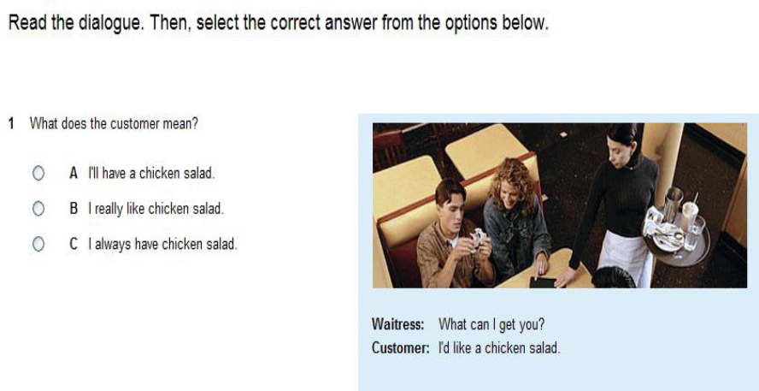
題 型 介 紹（第一大題：英文應用） Types of Questions – Part 1. Use of English
Choose answer.

Slide 7
題 型 介 紹（第一大題：英文應用） Types of Questions – Part 1. Use of English
當你按下”Next”跳到下一題之後，便無法回到上一題，已完成的題目也無法重新修改。You cannot go backwards to check or change your answers once you click on ”Next”.

Slide 8
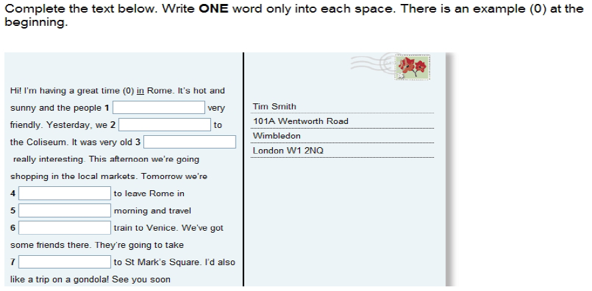
題 型 介 紹（第一大題：英文應用） Types of Questions – Part 1. Use of English
每個空格內只需填入一個字。Type only one word in each box.

Slide 9
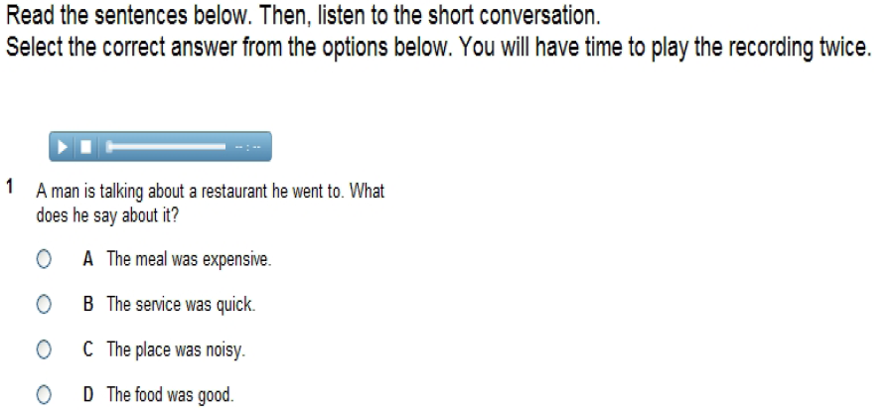
題 型 介 紹（第二大題：聽力測驗） Types of Questions – Part 2. Listening
Put on your earphones.
1) 請於音檔下載完畢，再撥放音檔。The media bar is shown when the audio file is fully downloaded. Please wait until it’s done.
2) 每道聽力題目只能聽 2 次。You can play the recording twice.
當你按下”Next”跳到下一題之後，便無法回到上一題，已完成的題目也無法重新修改。You cannot go backwards to check or change your answers once you click on ”Next”.

Slide 10
注 意 事 項 Attention
如遇到問題，請直接關掉頁面，系統會自動儲存你目前已完成的題目。
If interruptions occur during the test, just close all the explorer windows. Do not refresh the test webpage in any circumstances.
接續作答時，請使用原Username、Password 和 Organization ID登入，題目會從上次未完成的那題開始。
Log in to the test website again with the same username and password; the test will continue. The remote server saves the test progress in real time.
未於限定時間內完成作答者，則聽力測驗將沒有成績。
There is a time limit. Failure to complete all the questions results in no (zero) points in the listening part.

Slide 11
Start the Test

Slide 12
登 入 Log in https://www.oxfordenglishtesting.com/
進入頁面後，請先按下鍵盤上的”Shift + Ctrl + Delete”，清除瀏覽資料後再登入。
Before you begin, clear your web browser‘s cache by pressing “Ctrl + Shift + Delete” simultaneously on the keyboard.
User name | b + Student ID (e.g. b055***)
Password | Nssh202305
Organization ID | 073990

Slide 13
確 認 資 料 Confirm Personal Information
“First name”為學號，”Last name” 為姓名，請確認資料是否無誤。Please confirm your personal information.
“Email”為系統預設，不需更改。The “Email” is set as default. You don’t need to change it.
點擊”Save”前往下一步。Click on “Save” to continue.
1
2
3

Slide 14
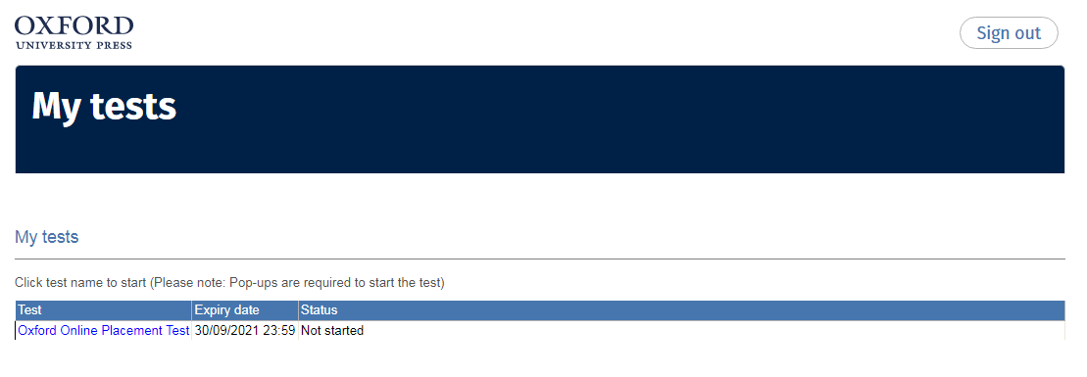
開 始 測 驗 Enter My Tests
點選此連結，並允許快顯視窗。
Click on the Placement Test.

Slide 15
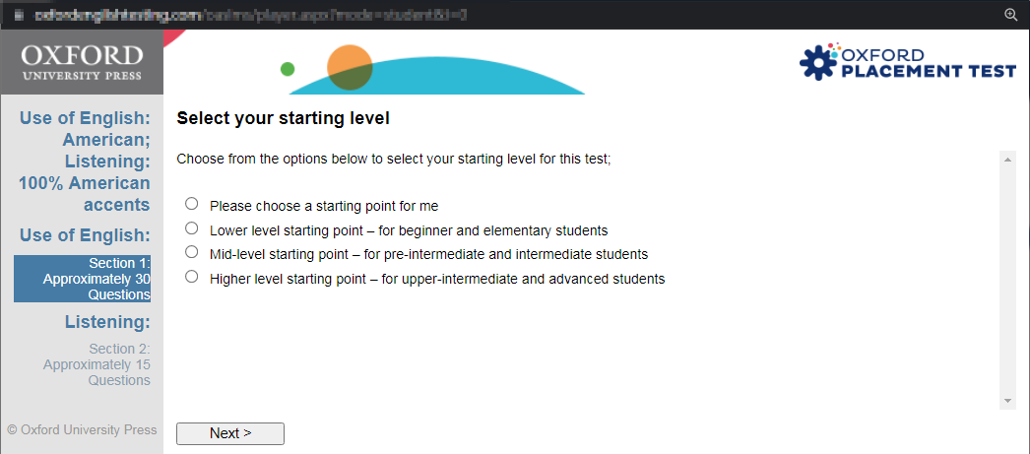
選擇初始難易度 Select Your Starting Level
本測驗為適性測驗，電腦會依據受測者答題對錯決定下一題難易度。本畫面選項僅決定測驗卷第一題難度，不影響測驗最終結果。 This is a computer-adaptive test. The level of the next question is decided by your answer to the current question.
1
到此步驟，請先暫停，勿按下一步。依監試人員指示，再按下一步，進入正式測驗。Do not click “Next” now. Proceed until further instructions.
2

Slide 16
After the Test

Slide 17
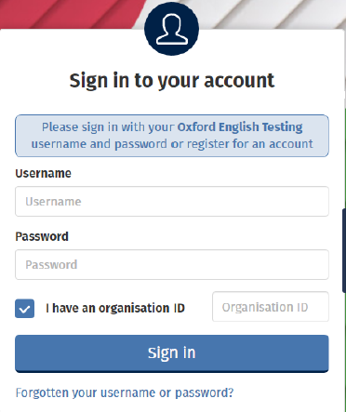
查 詢 成 績 Check the Results
作答完畢後，使用原Username, Password, Organisation ID再次登入，即可查看成績。You can check the results by logging in to the test website again.
User name | b + Student ID (e.g. b055***)
Password | Nssh202305
Organization ID | 073990

Slide 18
查 詢 成 績 Check the Results
1
2
Overall score
3
牛津分級測驗，滿分為120分，共分6級（CEFR A1~C2）。The test is scored on a scale of 0 to 120 points (CEFR A1~C2).

Slide 19
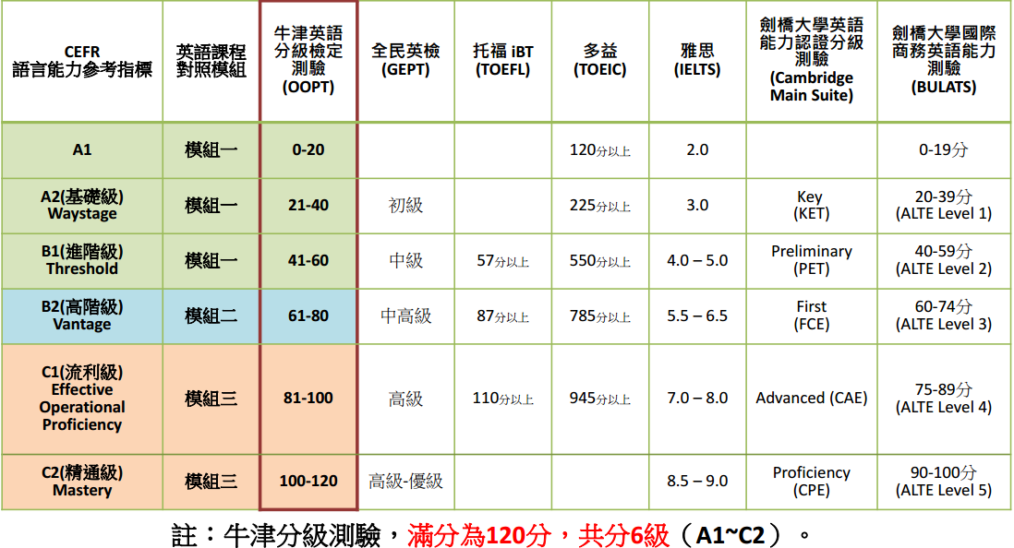
OPT / 英 語 測 驗 對 照 表
CEFR
OPT
牛津分級測驗，滿分為120分，共分6級（CEFR A1~C2）。The test is scored on a scale of 0 to 120 points (CEFR A1~C2).

Slide 20
Thanks!

